Slide 1
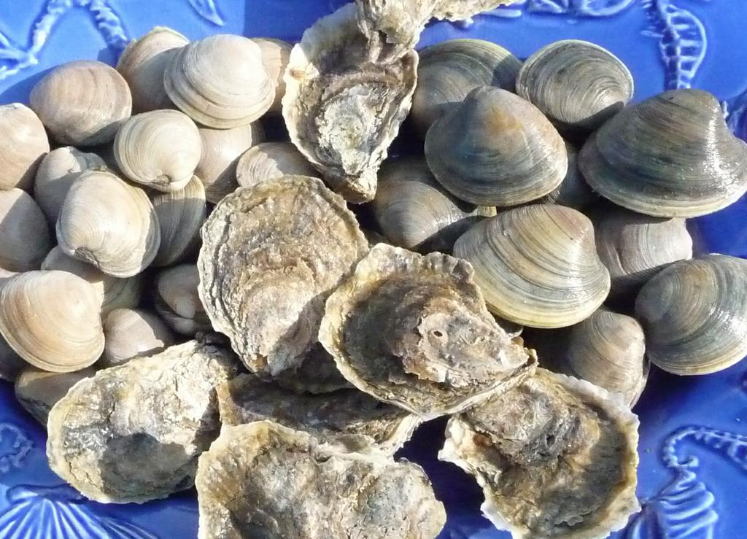
Status of New York State Vibrio
Illnesses and Control Plan
October 28, 2015
Debra Barnes, Bureau of Shellfisheries
National V.p. Workshop
Baltimore, MD
September 6, 2017

Slide 2
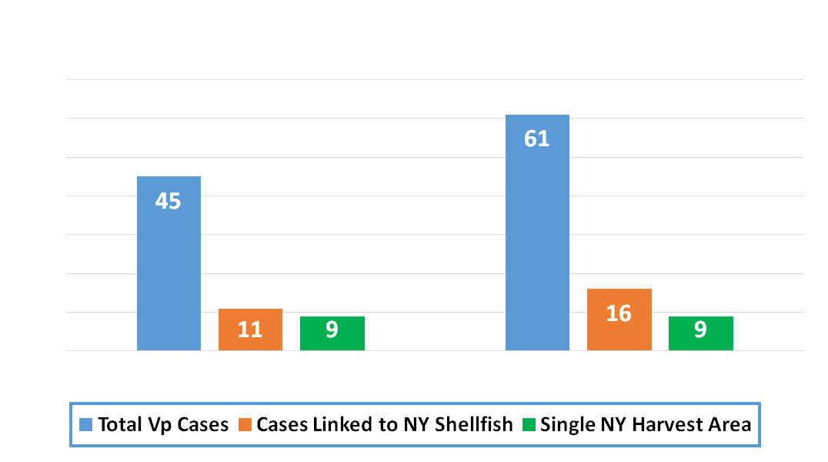
New York Vp Illness Summary 2012-2013
Single Harvest Area: Outbreaks in Oyster Bay/Cold Spring Harbors NS2; Multi-State; Pacific NW Strain of Vp (04:K12 & 04:K Unknown)

Slide 3
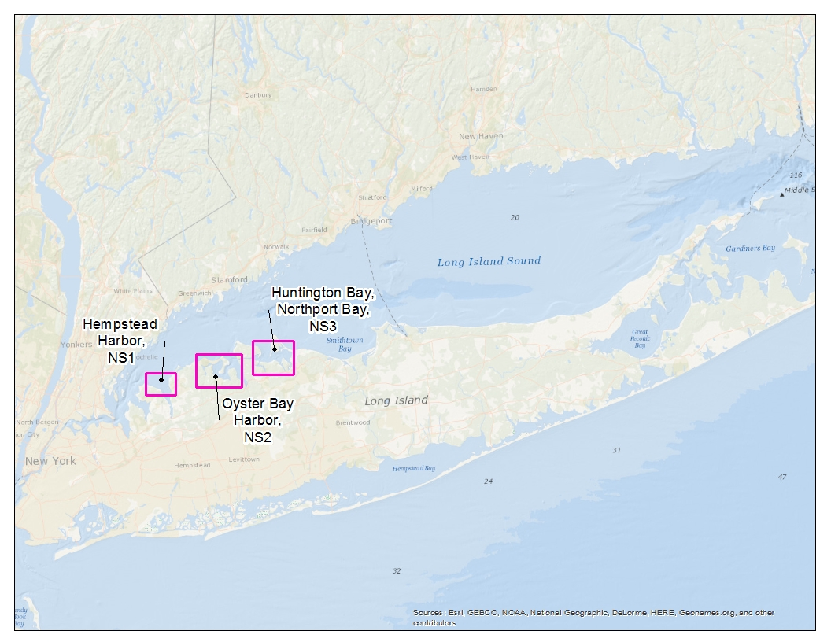
VpCP Harvest Areas
NS1, NS2, NS3 & LS1 West of Eatons Neck Point
LS1 West (LS1W)

Slide 4
Changes in Vp Control Plans 2012 - 2016
Year | Harvest Areas VpCP | Shellfish Type | Time to Temperature (Cooling) | Internal Shellstock Temperature | Original Dealers (Shippers)
2012 | Vp Outbreak NS2 (no VpCP – Not Mandatory) | NA | NA | NA | NA
2013 | Vp Outbreak NS2 (VpCP – BMPs –Cooling Not Mandatory) | Hard Clams and Oysters | BMP – cooling, refrigeration within 5 hours of harvest | NA | BMP - Cooled to 50°F within 10 hours of refrigeration
2014 | NS1, NS2, & LS1 (west of Lloyd Pt) | Hard Clams and Oysters | 1 hour to icing or 5 hours to refrigeration | Cooled to 68°F prior to sale to original dealer | Cooled to 50°F within 10 hrs of time of harvest & prior to shipment
2015 | NS1, NS2, NS3 & LS1 (west of Eatons Neck Pt) | Hard Clams and Oysters | 1 hour to cooling; icing, refrigeration or slurry | Cooled to 60°F prior to sale to original dealer | Cooled to 50°F within 10 hrs of time of harvest & prior to shipment
2016 | NS1, NS2, NS3 & LS1 (west of Eatons Neck Pt) | Hard Clams and Oysters | Immediate cooling; icing, refrigeration or slurry | Cooled to 60°F prior to sale to original dealer | Cooled to 50°F within 10 hrs of time of harvest & prior to shipment

Slide 5
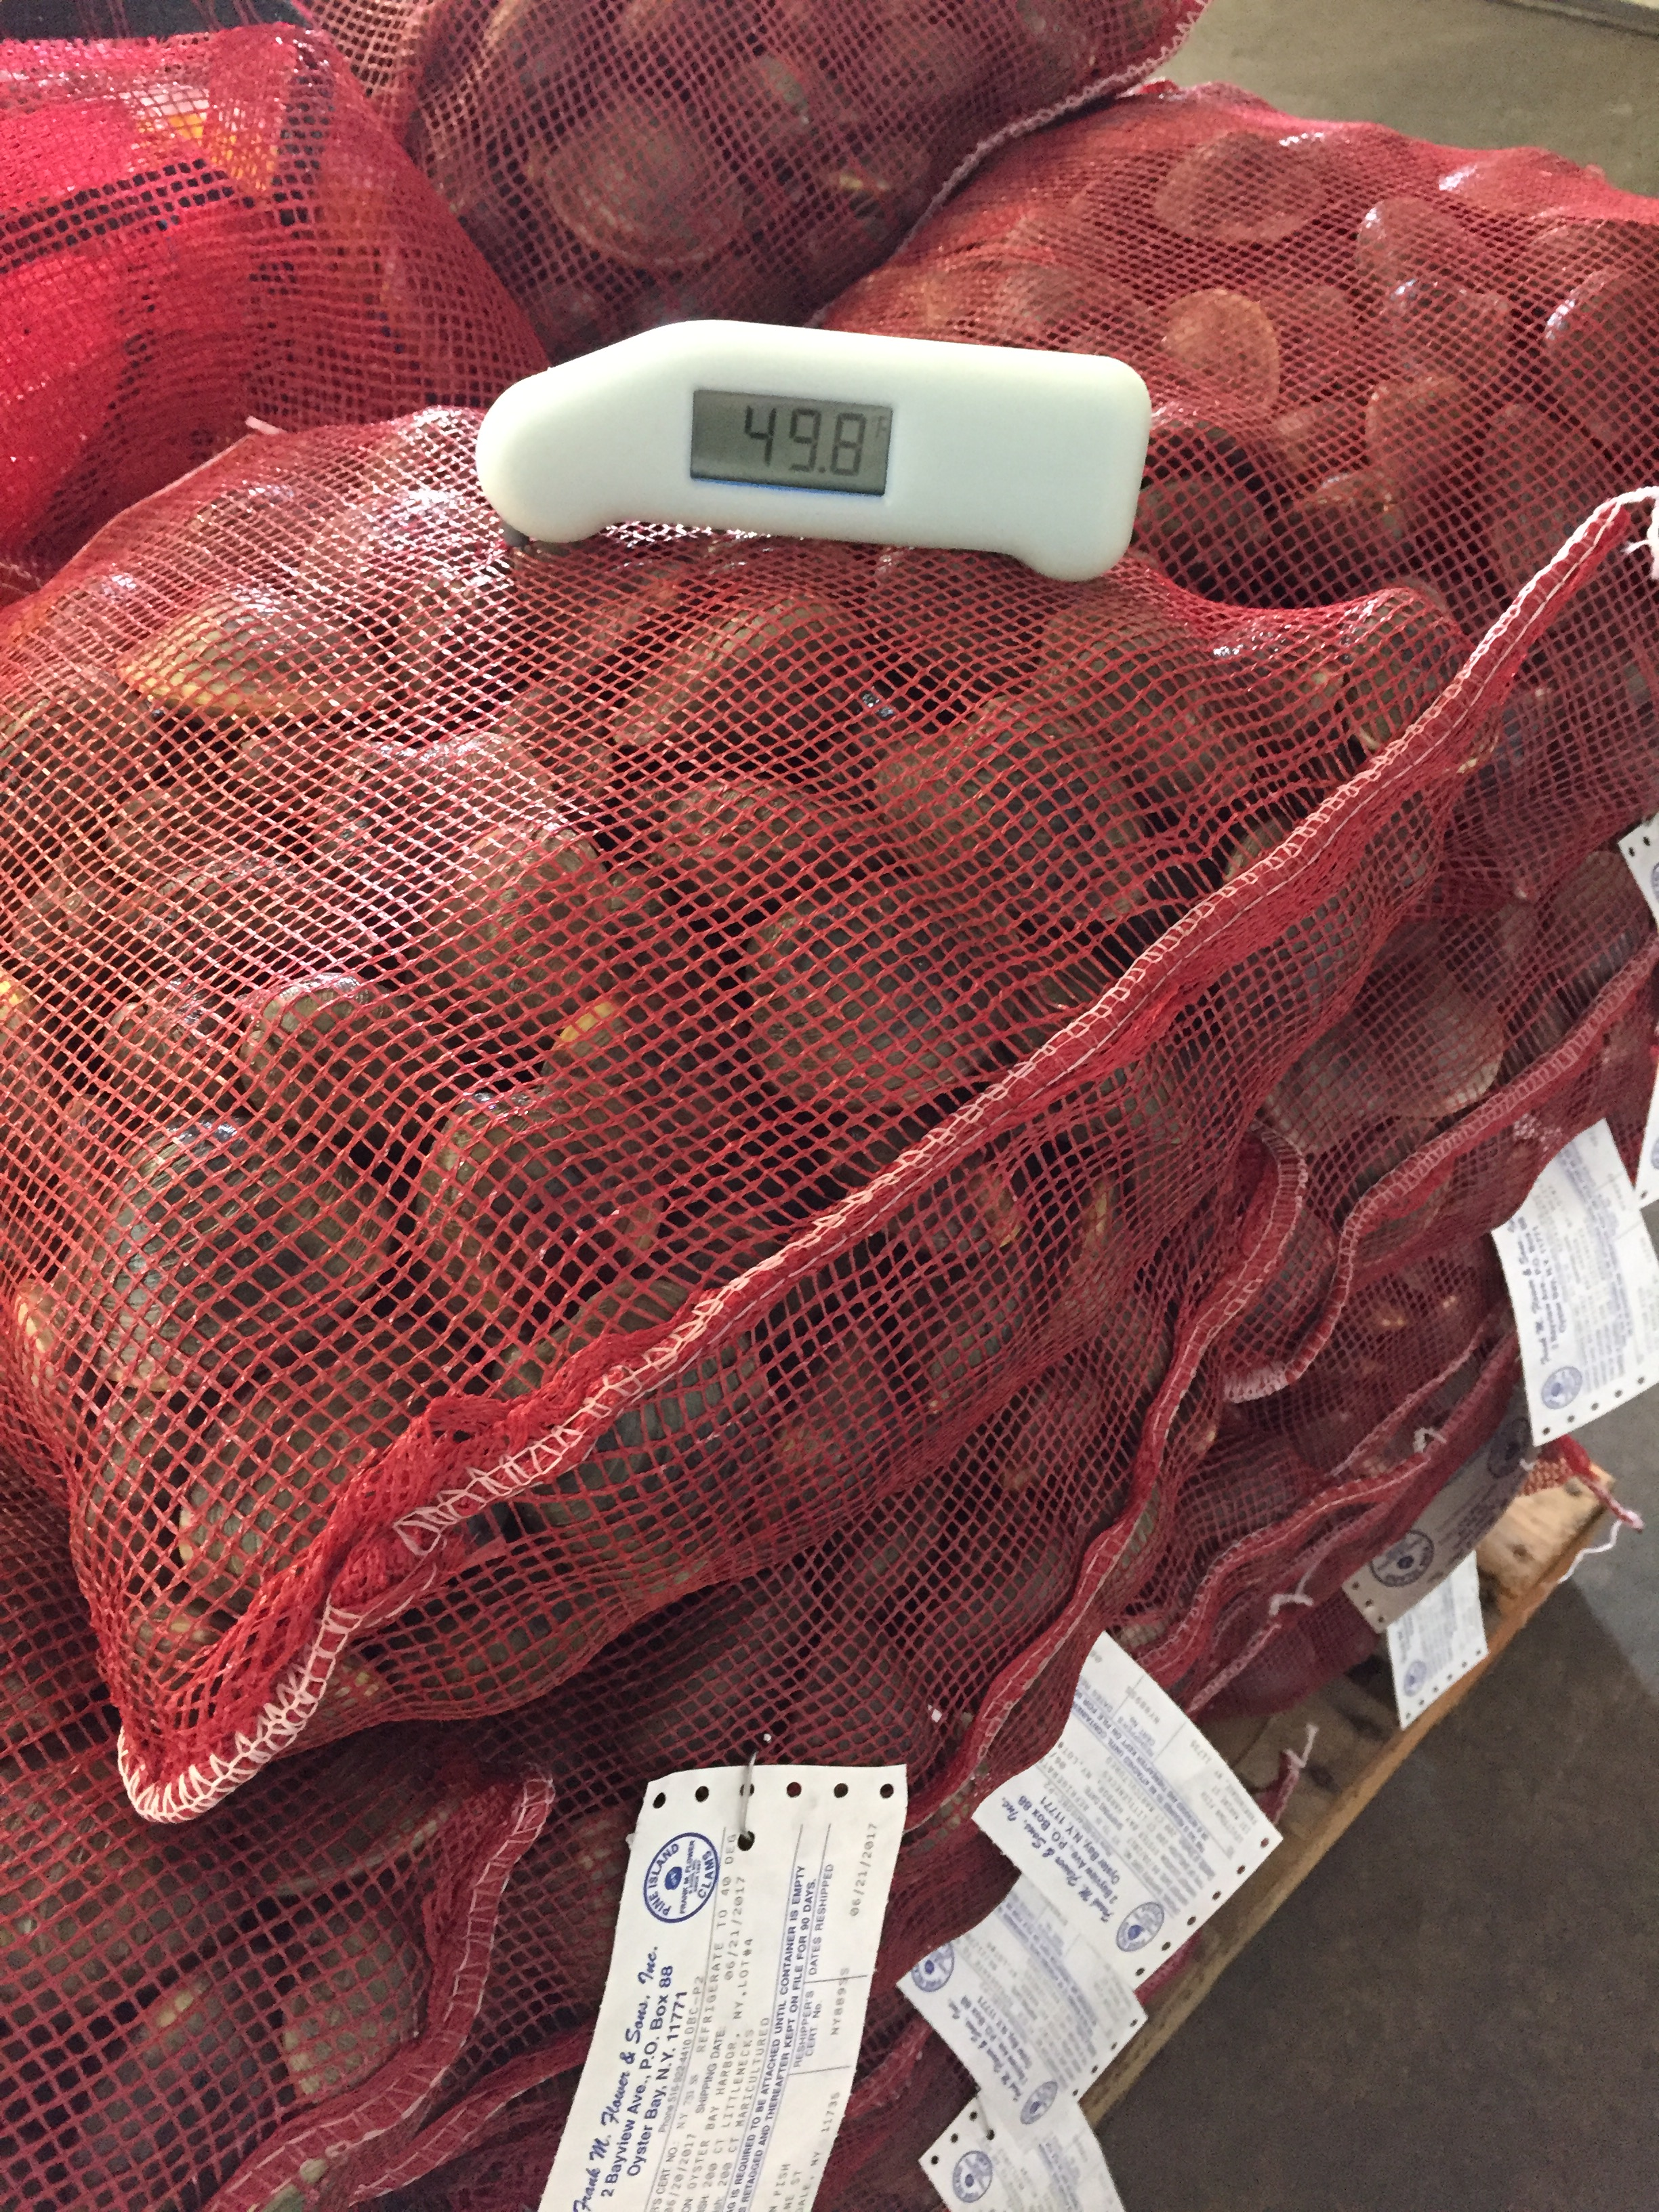
2017 Vp Control Measures
Effective May 1 – September 30
Applies to Hard Clams & Oysters in VpCP Areas
Shading of shellstock May 1 – Oct 31
Immediate culling and then cooling by refrigeration or icing of oysters and clams following Time of Harvest (cull and cool once harvest begins)
Internal temperature of shellstock must be cooled to 60ºF or less prior to sale to original dealer
Immediate refrigeration or icing applies to all oyster harvest in NYS
All shellstock must be cooled to 50ºF within 10 hours of time of receipt by shipper and prior to being shipped

Slide 6
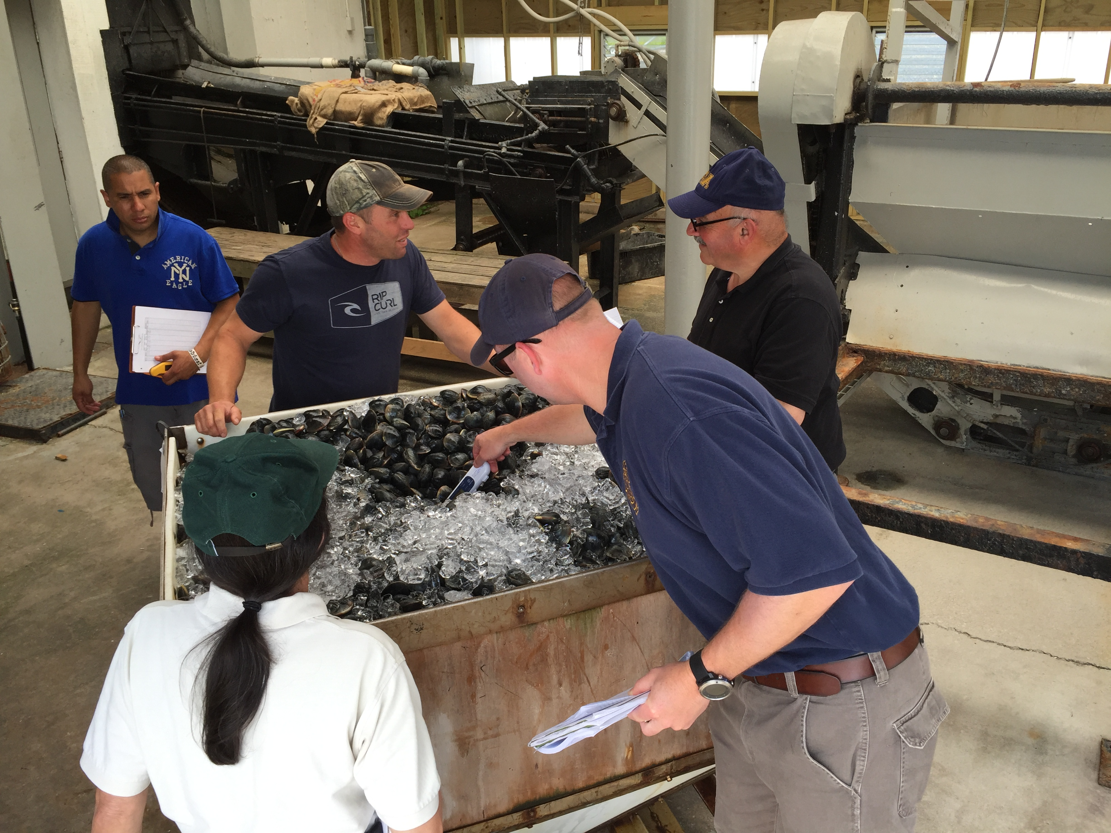
2017 Vp Control Measures
All requirements for diggers (harvesters) are the same as 2016
Only change applies to shellfish shippers
All shellstock must be cooled to 50ºF within 10 hours of time of receipt and prior to shipping
Shippers must record time shellstock reaches 50ºF as HACCP record

Slide 7
2015 - 2017 VpCP Harvest Areas
NS1, NS2, NS3 & LS1 West of Eatons Neck Point

Slide 8
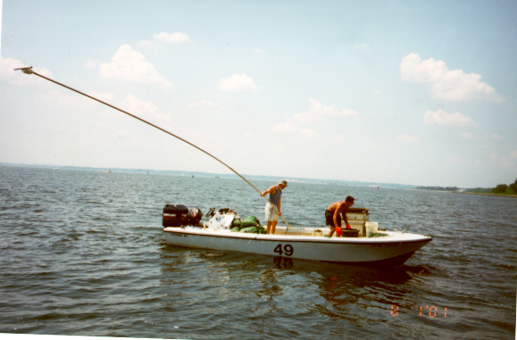
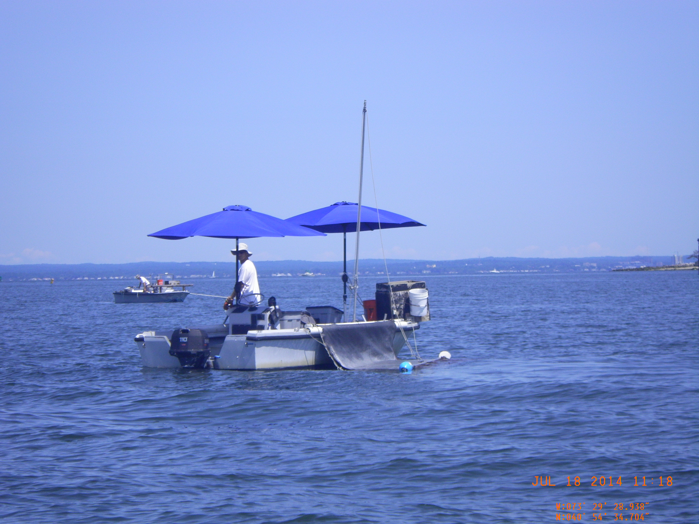
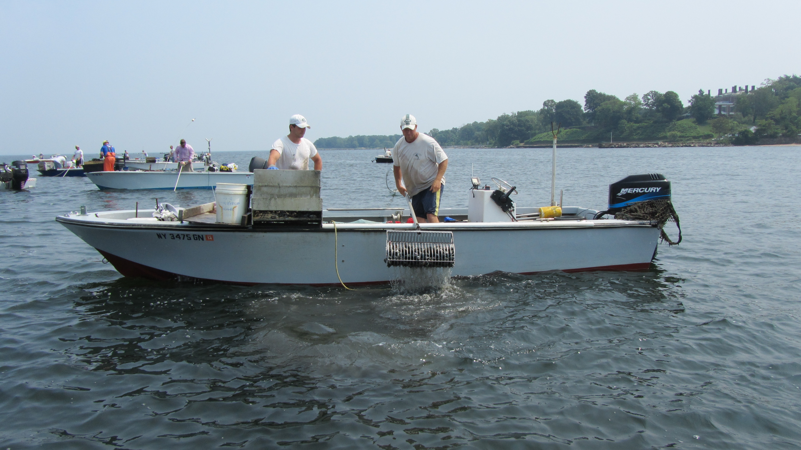
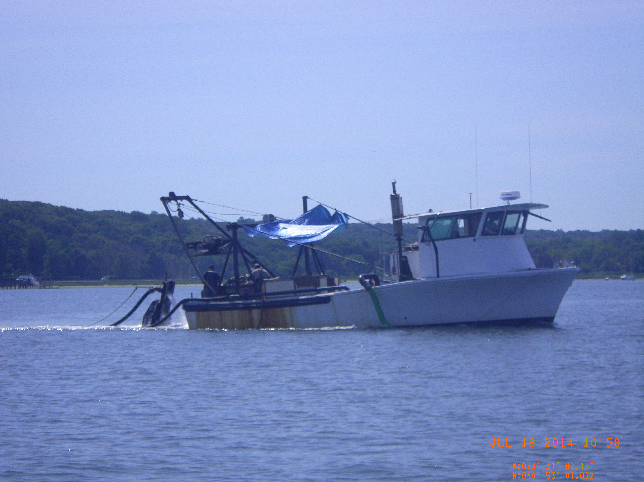
Oyster and Hard Clam Harvesting Methods

Slide 9
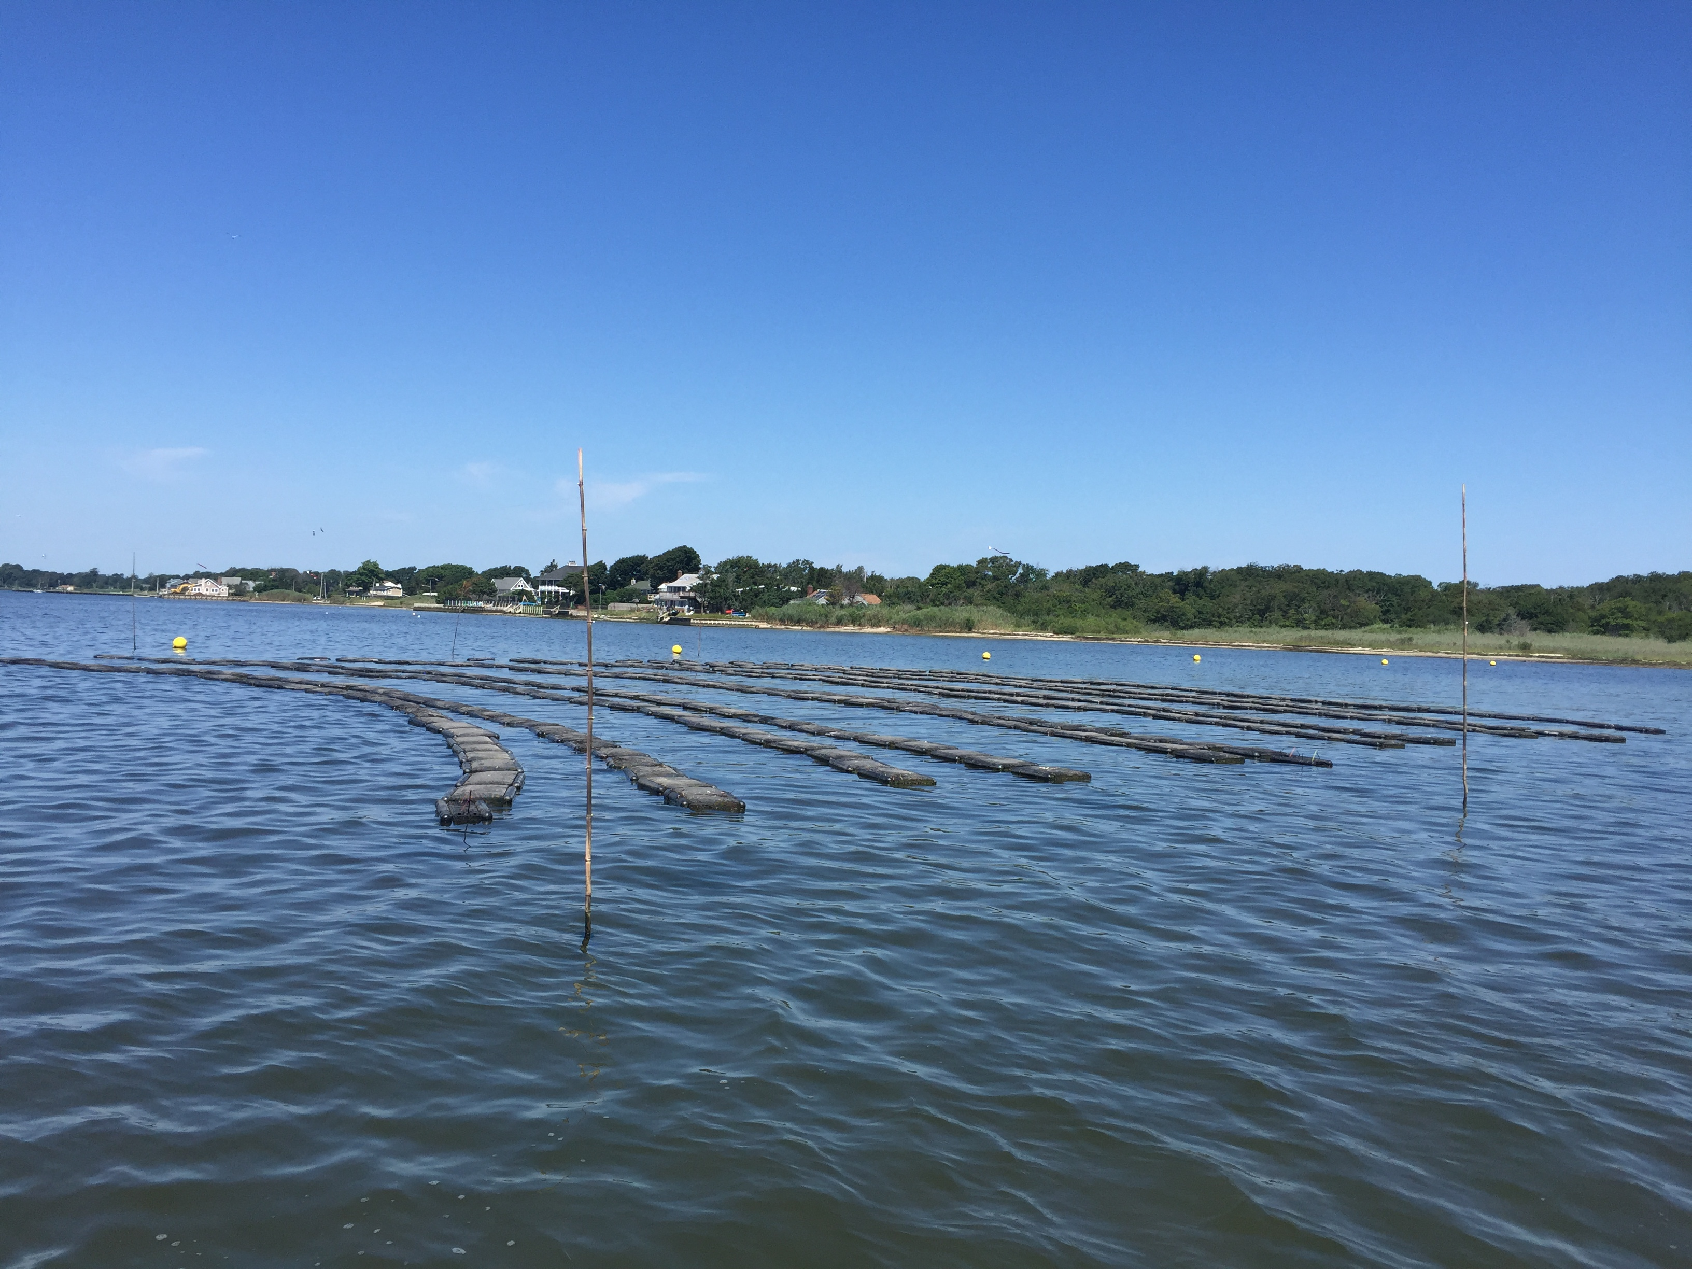
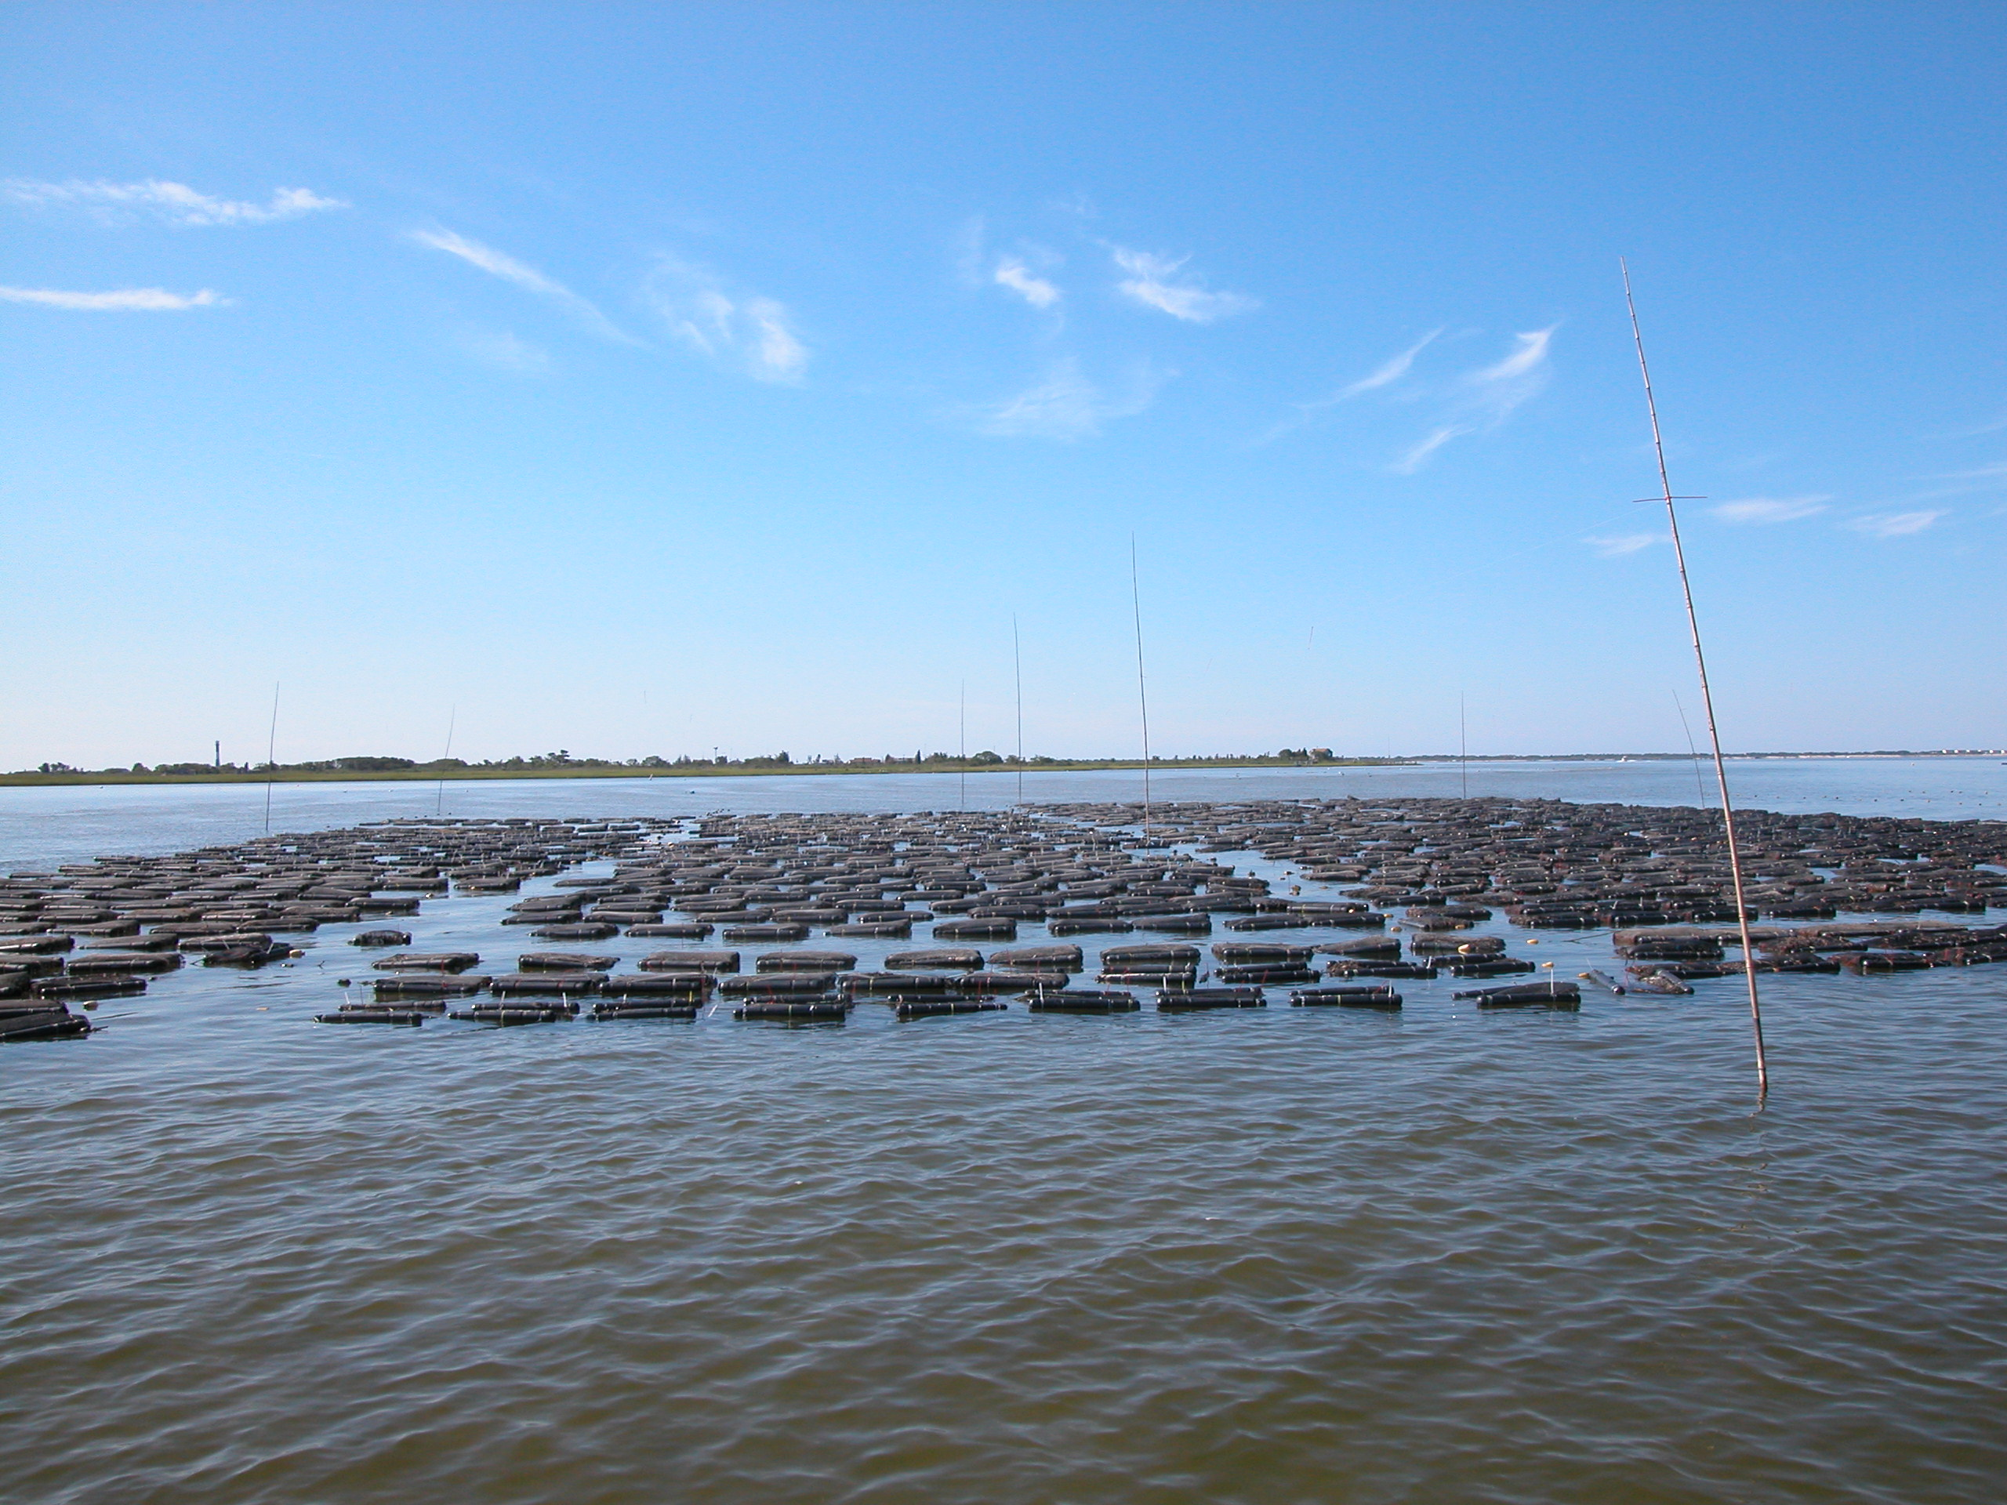
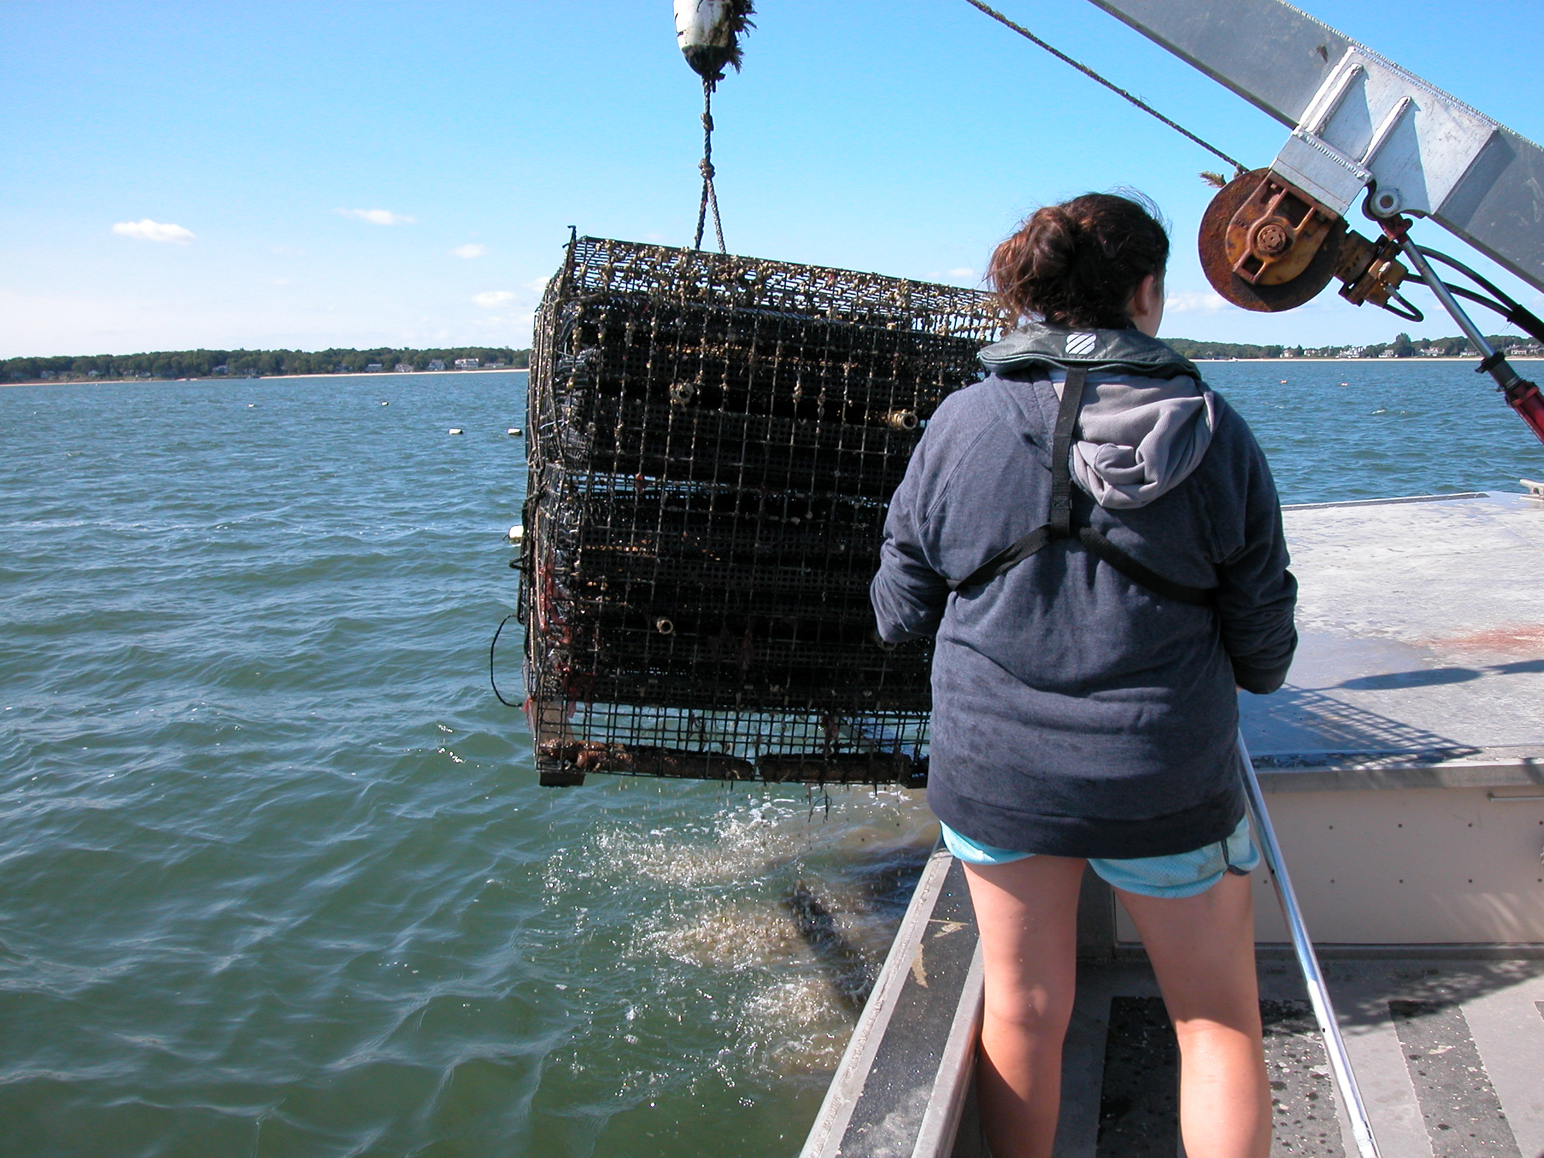
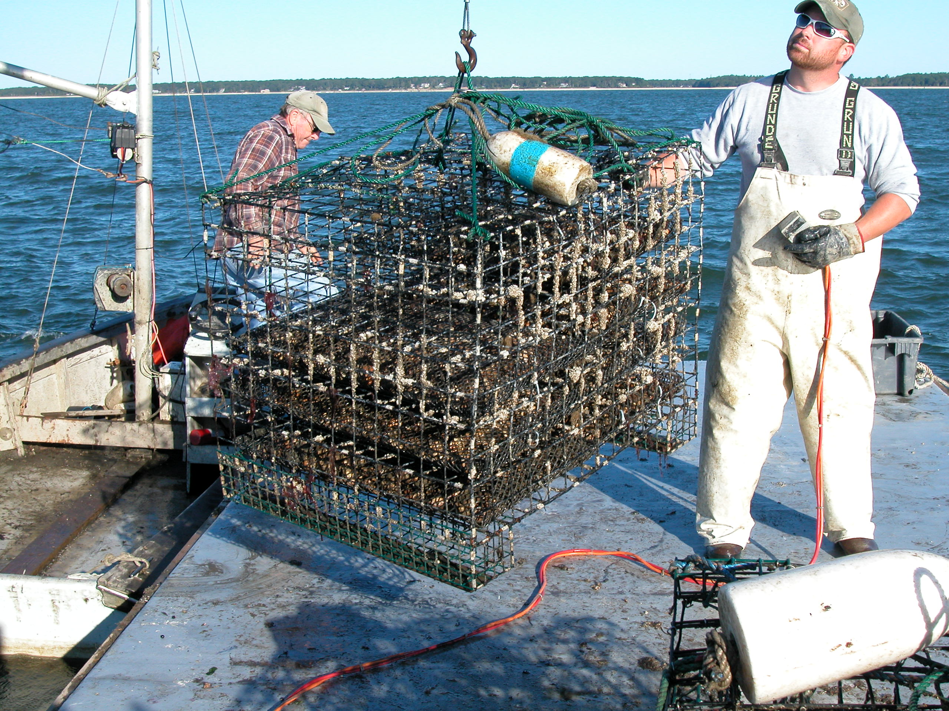
Oyster Cultivation Methods – Floating & Submerged Gear

Slide 10
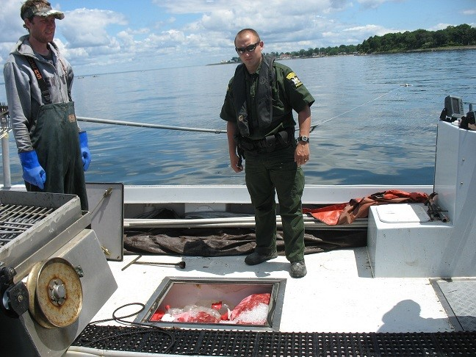
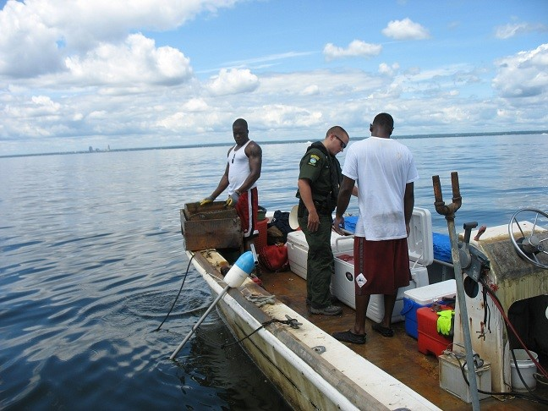
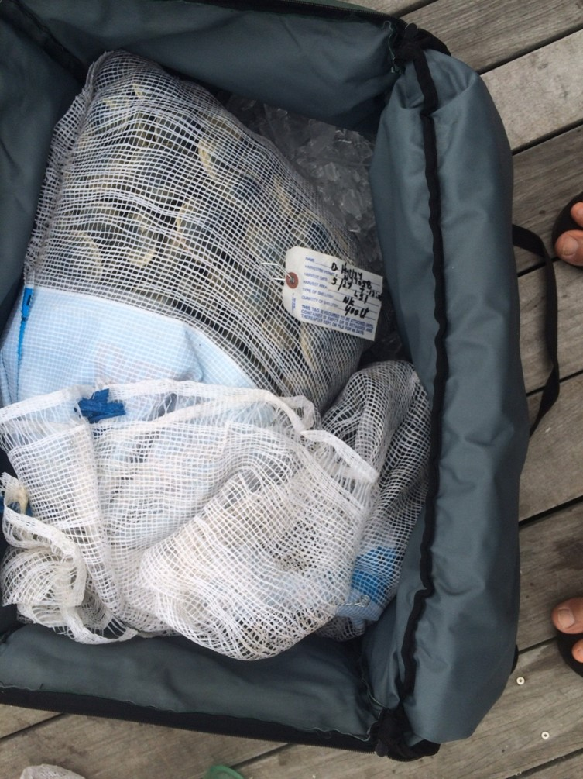
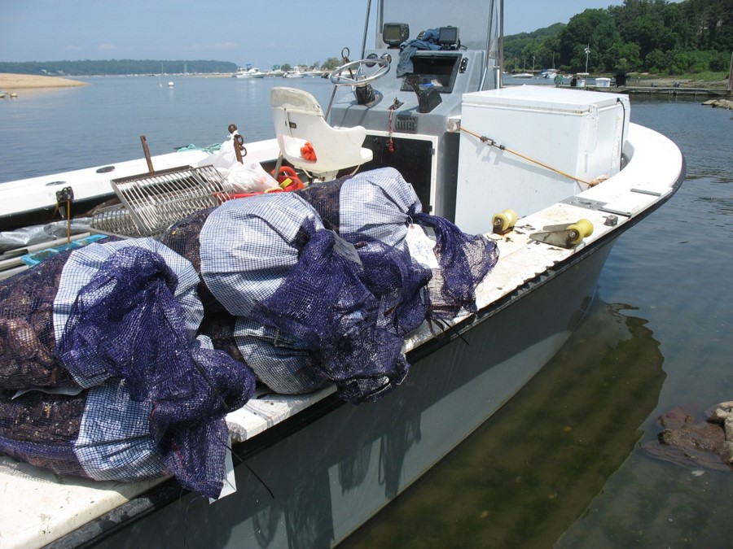
Onboard Cooling Methods – Icing & Refrigeration
Below Deck Cooler Compartment
Insulated Hard Coolers
Soft-Sided Cooler Bags
Onboard Refrigeration

Slide 11
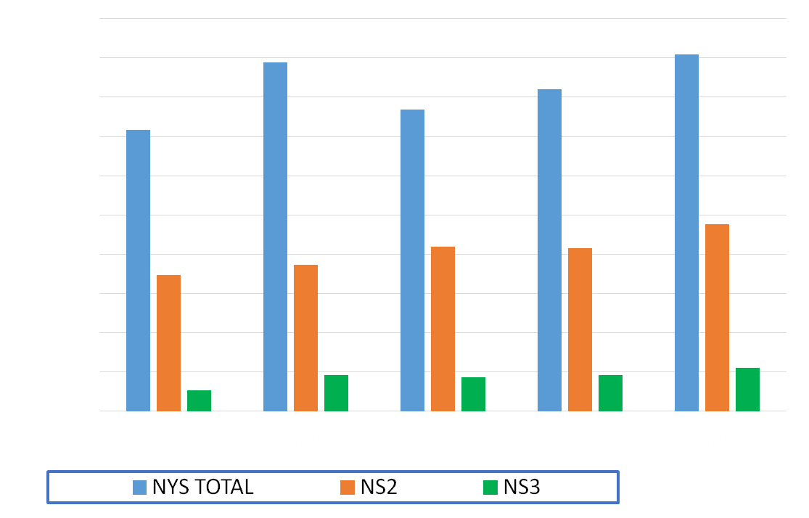
New York State Hard Clam Landings (Bu) 2012-2016

Slide 12
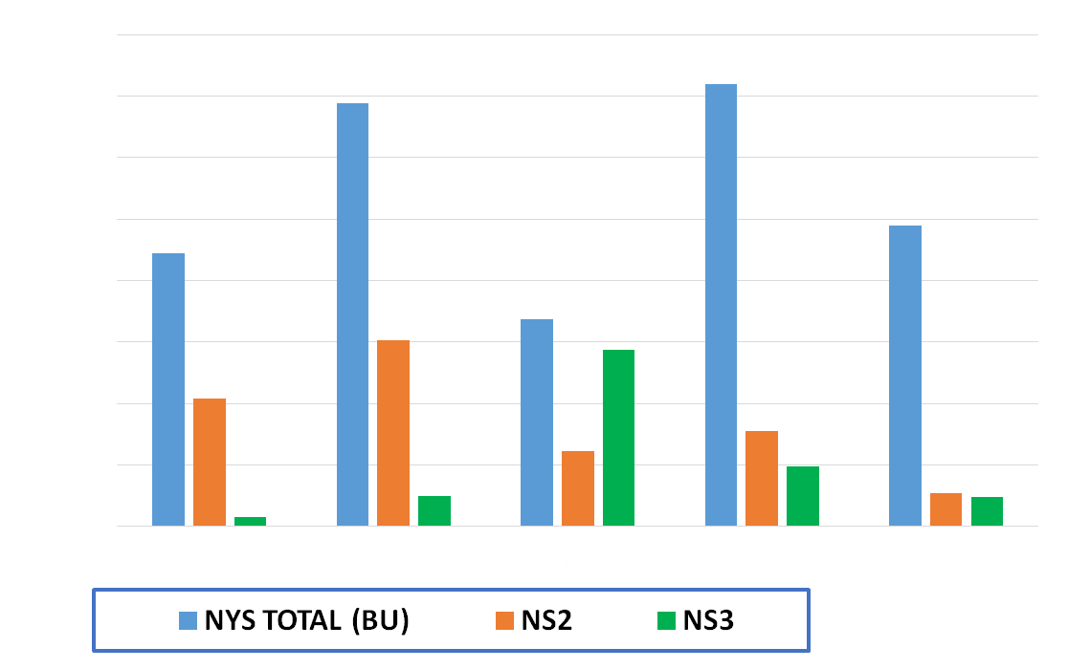
NYS Oyster Landings (Bu) 2012-2016

Slide 13
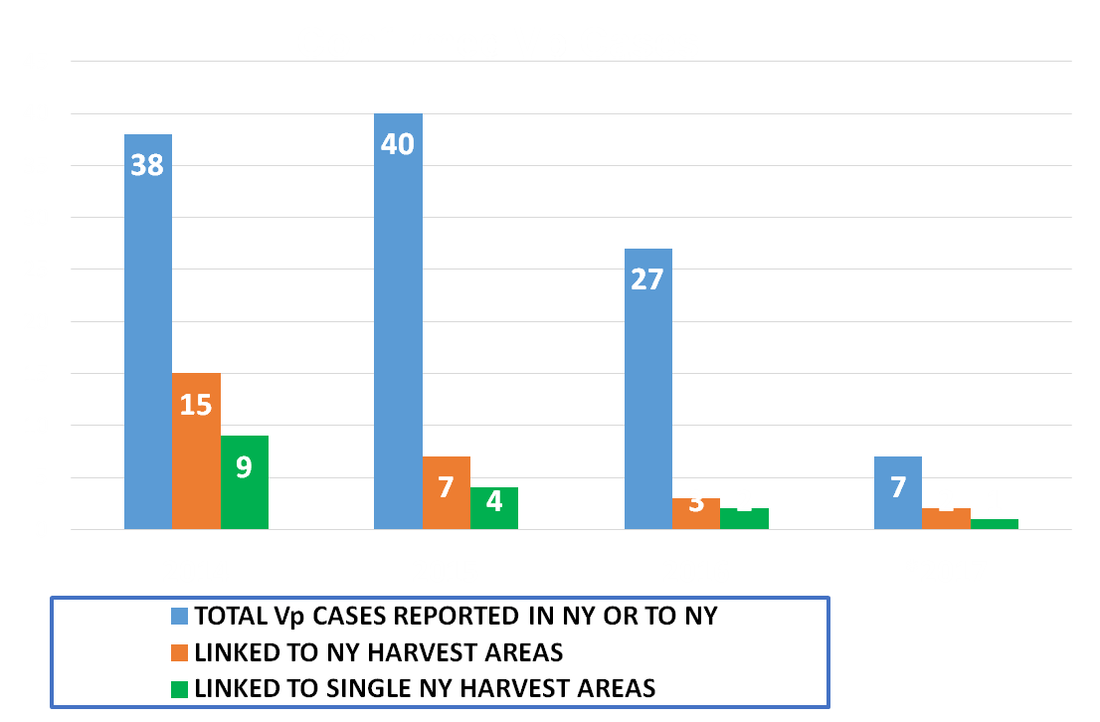
NY Vp Illness Summary 2014 - *2017

Slide 14
NY Vp Illness Summary 2014 - *2017

Slide 15
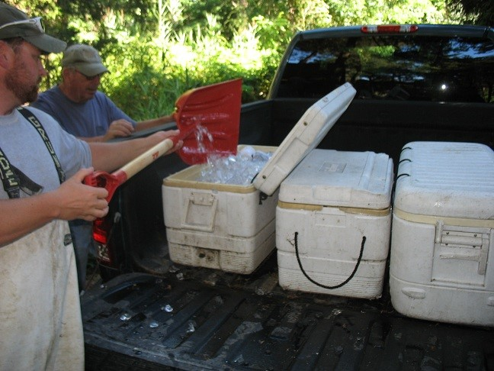
Summary: Factors Affecting Reduction in Vp Illnesses
Sporadic illnesses only (2015-2017)
Reduced time to cooling (icing and refrigeration): from 1 hour to immediately following start of harvest
Oyster and clam internal temperature at sale to original dealer – 60ºF
Industry compliance – high;
Ice supplied by shellfish dealers
All New York oyster harvest subject to immediate cooling once harvest begins
Outreach to diggers and shippers
Increased Enforcement and field compliance of Vp Control Measures

Slide 16
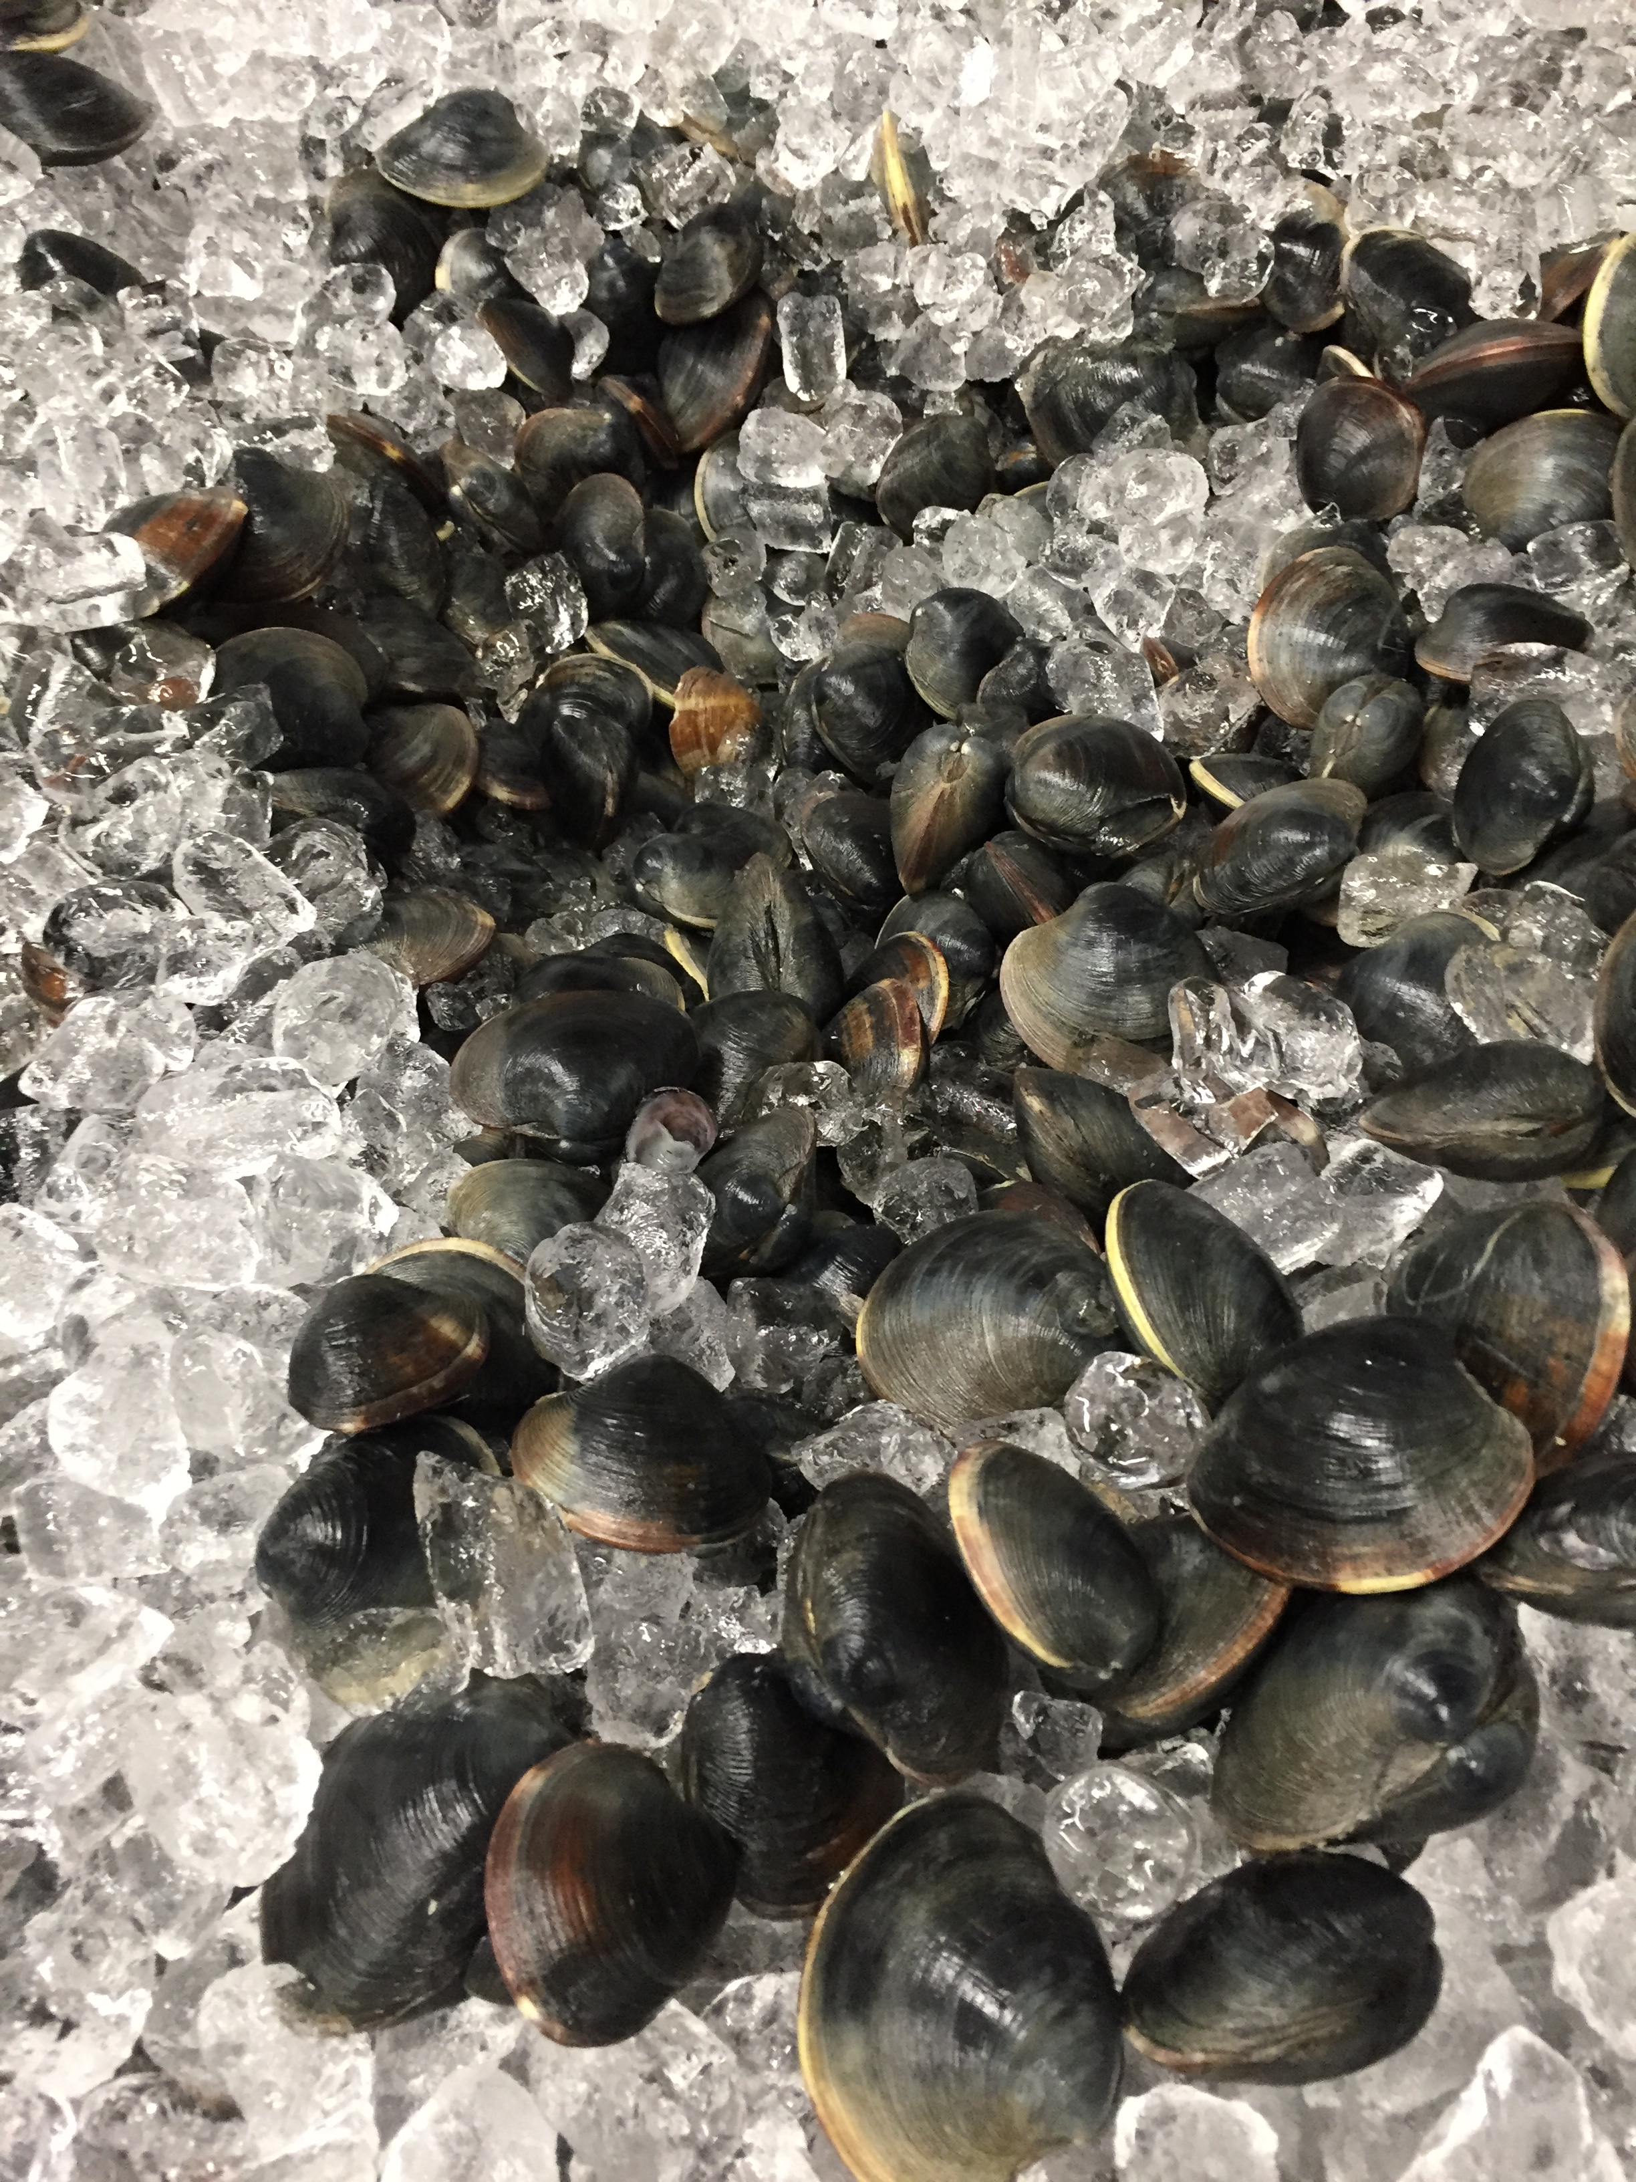
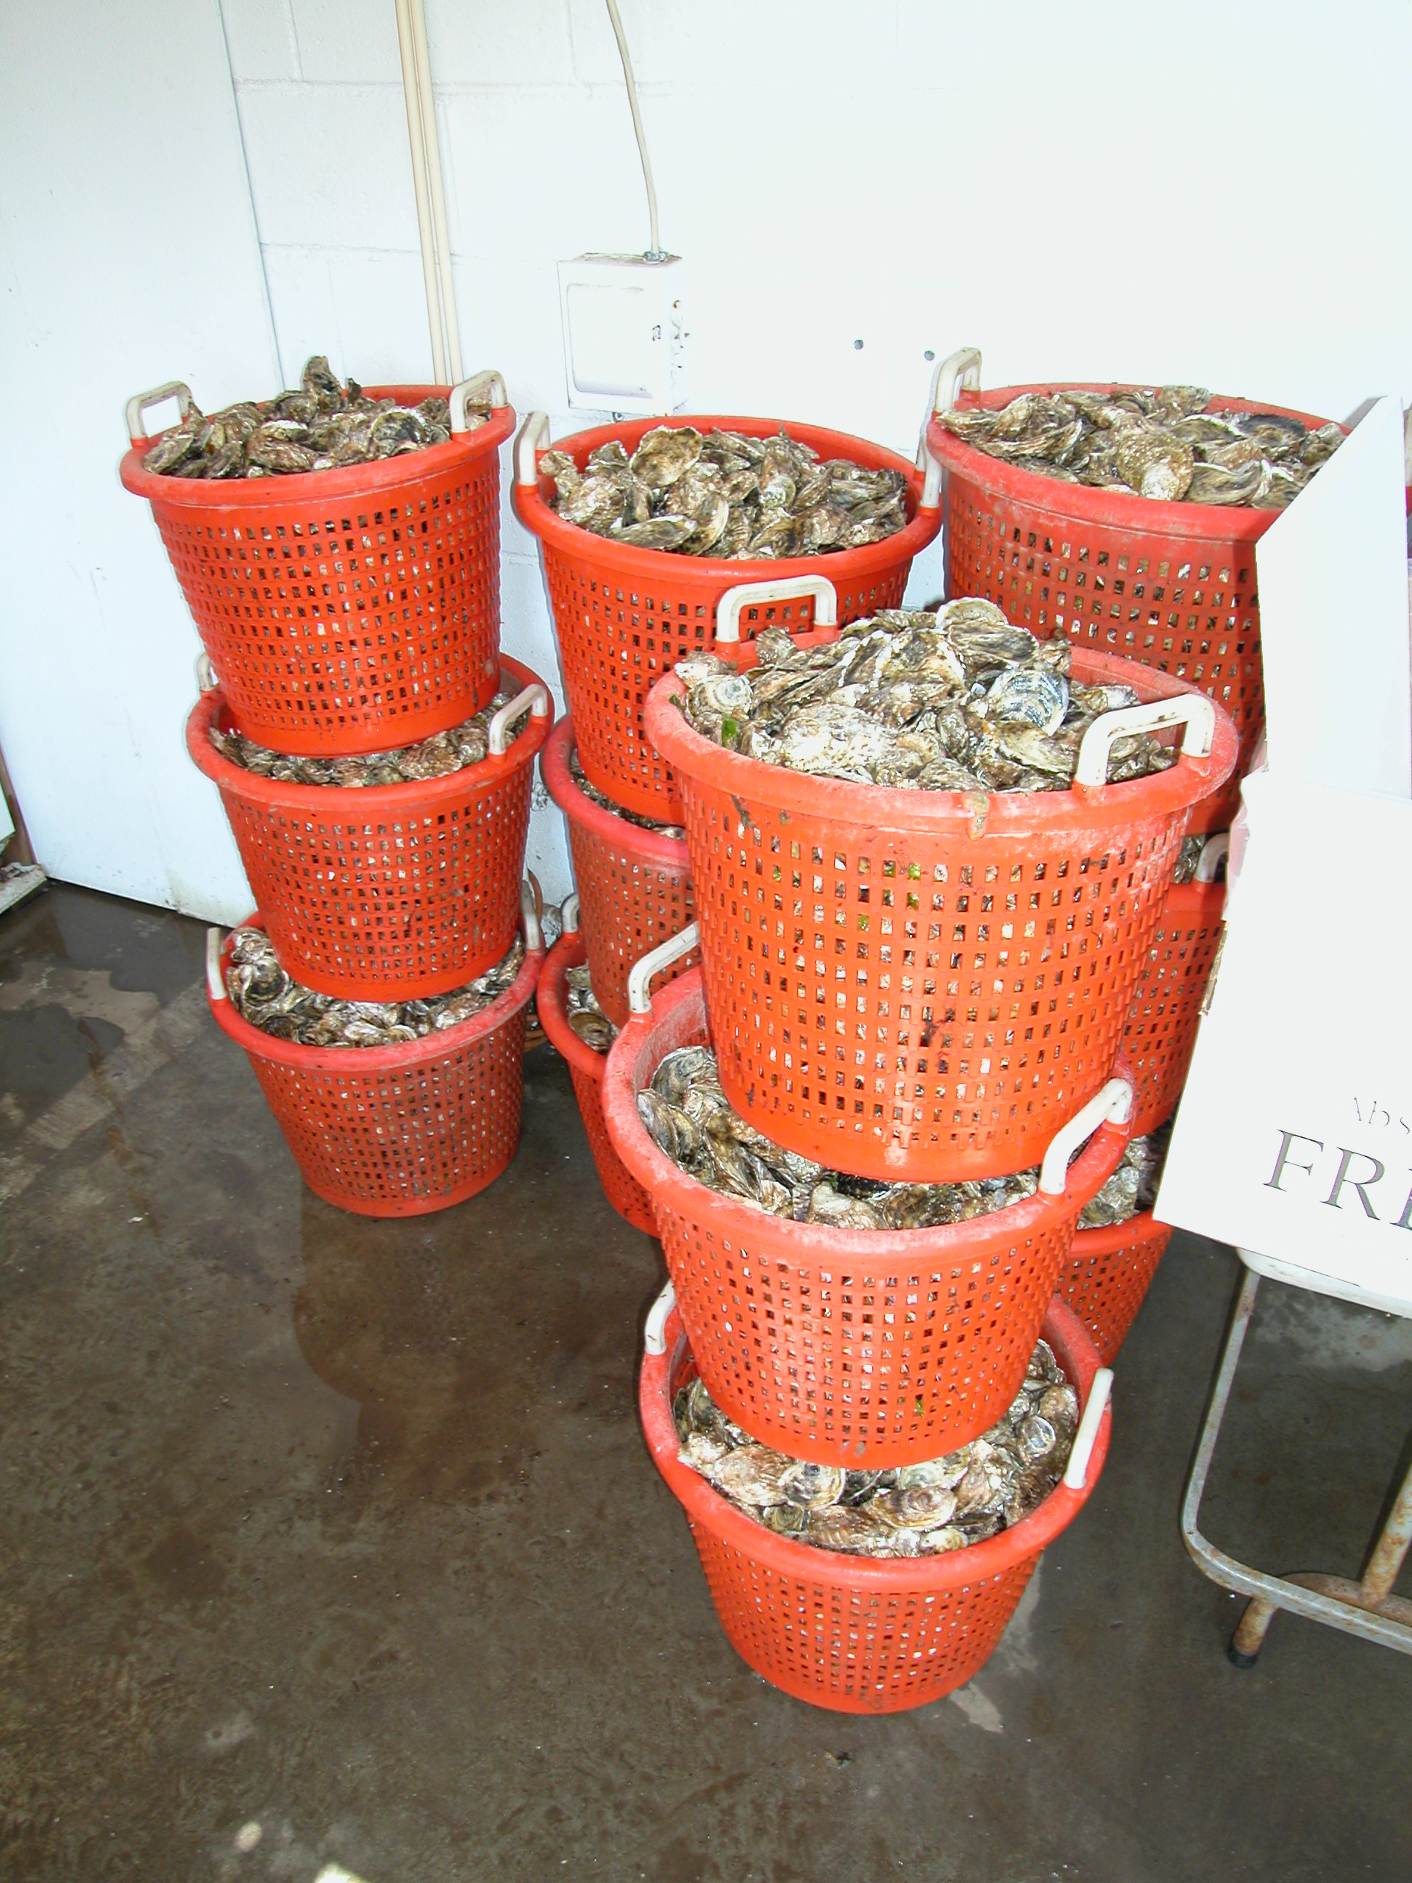
Debra A. Barnes
NYSDEC, Division of Marine Resources
Shellfisheries Bureau
205 N. Belle Mead Road, Suite 1
East Setauket, NY 11733
631-444-0477
www.dec.ny.gov

