Slide 1
Environmental Conditions Associated with Elevated
Total V.p. Concentrations in Oysters
--Growing Area Scale Studies--
Steve Jones
Meghan Hartwick, Cheryl Whistler, Erin Urquhart
University of New Hampshire

Slide 2
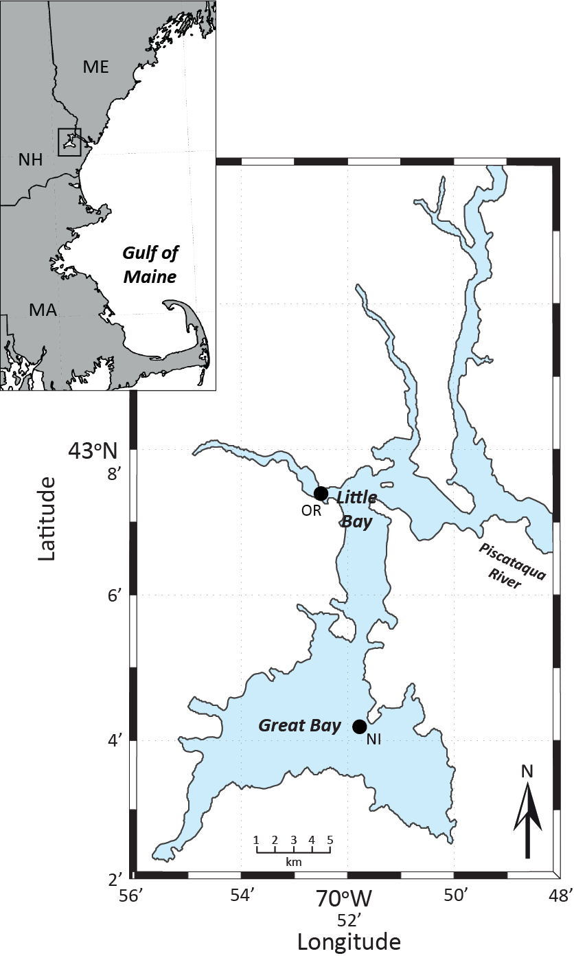
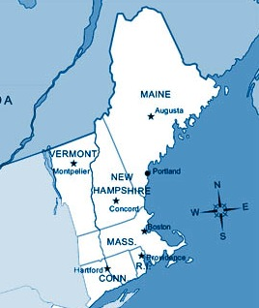

The Great Bay Estuary
in New Hampshire and Maine
Promatdstribution.com
Notes:
Pathogenic serotypes and sequence types are not frequently isolated from the environment and mechanisms of pathogenicity is currently not identified
Elevated V. parahaemolyticus concentration is frequently associated with increased disease incidence (eg: Grimes et al., 2015).

Slide 3
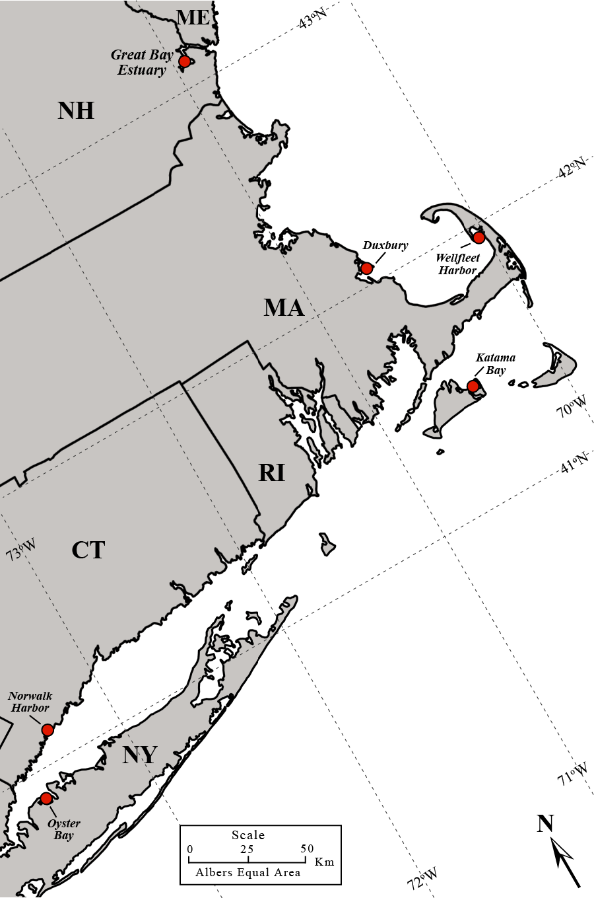
Sea surface temperature at buoys in
Long Island Sound, Gulf of Maine
and Great Bay Estuary in June
GBE
A01
Coastal conditions-SST- have been changing
& becoming more favorable for Vibrio species
EXRX

Slide 4
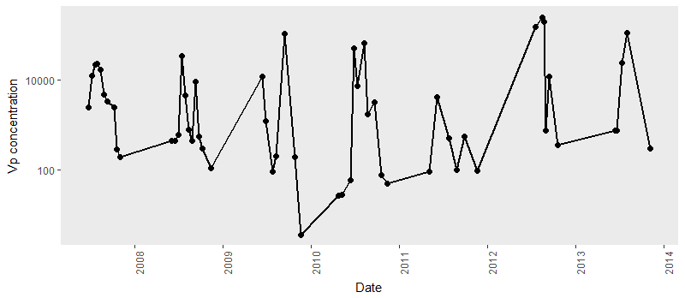
What conditions contribute to patterns we see for V.p. concentrations in the Great Bay Estuary?

Slide 5
Sea surface temperature at buoys in Long Island Sound (EXRX), Gulf of Maine (A01)
and Great Bay Estuary (GBE) in June:
2004-2013 & 2002-2017

Slide 6
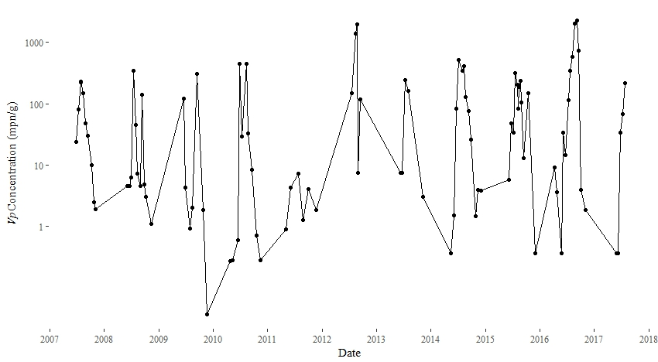
V.p. concentrations in the Great Bay Estuary through August 2017

Slide 7
Geometric mean monthly V. parahaemolyticus concentrations
(Vp/100 g)in Nannie Island (NH) oysters during 2 to 3 year increments from 1993 to 2015
Notes:
05/16/02
23

Slide 8
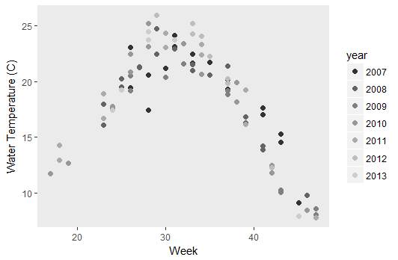
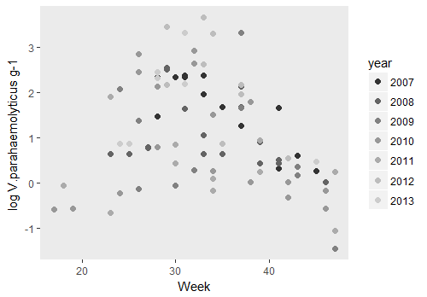
Temperature is an important condition for V. parahaemolyticus
Temperature and V. p. concentrations appear to have similar seasonal patterns
Notes:
But if we take a closer look…

Slide 9
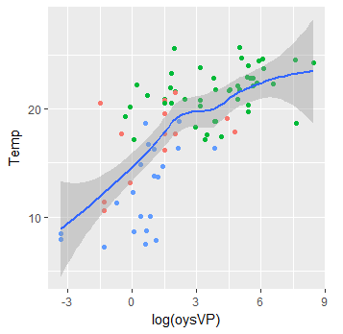
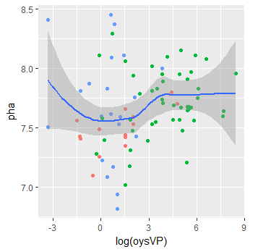
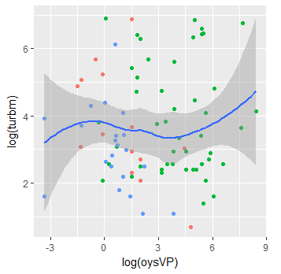
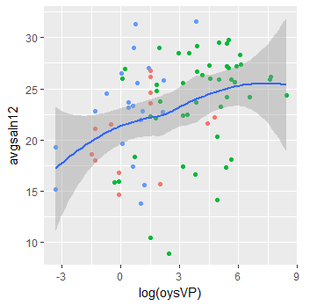
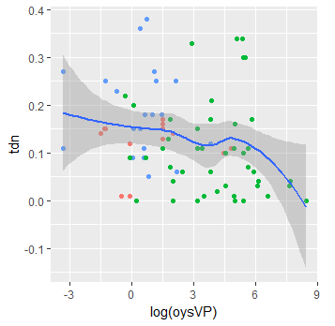
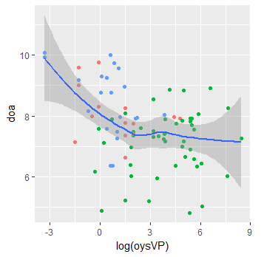
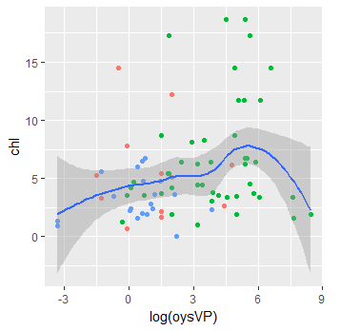
Relationships between single parameters and V.p. concentrations

Slide 10
Univariate regression identified linear and non-linear relationships
between environmental conditions and V. parahaemolyticus concentrations
 |  | Linear |  | Non-Linear
Variable | r² | % Deviance | p | r² | % Deviance | p
Temp | 0.479 | 48.6% | 3.58E-13 | 0.479 | 48.6% | 4.60E-14
Avg Saln | 0.116 | 12.7% | 1.00E-03 | 0.126 | 14.5% | 4.70E-03
Avg pH | 0.024 | 3.6% | 8.99E-02 | 0.21 | 24.6% | 0.0014
Avg DO | 0.123 | 13.4% | 7.13E-04 | 0.191 | 21.4% | 5.20E-04
Max Turb | 0.002 | 1.4% | 2.78E-01 | 0.057 | 9.9% | 2.11E-01
CHL | 0.077 | 8.9% | 6.63E-03 | 0.077 | 8.9% | 6.60E-03
TDN | 0.038 | 5% | 4.40E-02 | 0.012 | 14.1% | 0.014
Temperature was determined to be the strongest individual condition for estimating V. parahaemolyticus concentration.
The interactions between V.p. concentrations and pH, turbidity and DO were determined to be non-linear as the significance and deviance explained increased notably using non-linear regression.

Slide 11
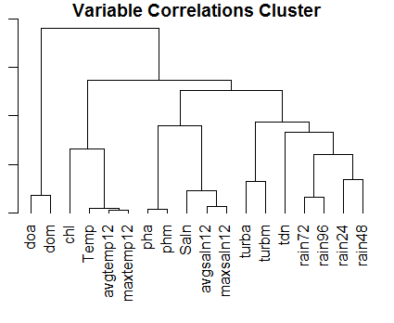
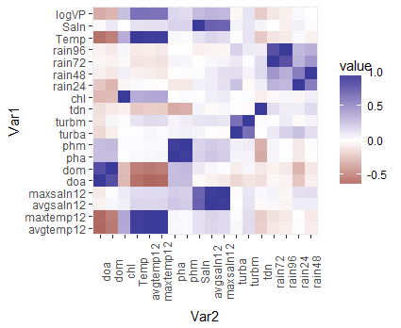
Correlation Clustering between Environmental Conditions and V. parahaemolyticus concentrations in GBE oysters
Seven of eighteen different measures of biological, climate and environmental conditions were determined to be uniquely correlated to V. parahaemolyticus concentrations in the GBE.
Clustering was used to identify inter-correlated conditions and the strength of the relationship within those colors can be visualized by the intensity of their corresponding location within the heatmap.

Slide 12
What conditions contribute to patterns we see in the Great Bay Estuary?
Seasonality

Slide 13
What conditions contribute to patterns we see in the Great Bay Estuary?

Slide 14
Seasonal Segmentation
Variable | Overall (R) (n=82) | Season
 |  | Spring (n=14) | Summer (n=47) | Fall (n=21)
Model | 0.87 | 0.78 | 0.69 | 0.75
Temp | 0.70 | 0.50 | 0.37 | 0.61
Avg Saln | 0.36 | 0.28 | 0.34 | 0.44
Avg pH | 0.19 | 0.63 | 0.19 | -0.12
Avg DO | -0.37 | -0.37 | 0.16 | -0.46
MaxTurb | 0.12 | -0.13 | 0.01 | -0.07
TDN | -0.22 | 0.08 | -0.09 | -0.14
CHL | 0.30 | -0.05 | 0.18 | 0.10
Segmentation highlights season-specific contribution of conditions to estimate V. p. concentrations

Slide 15
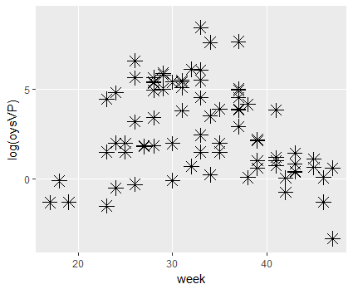
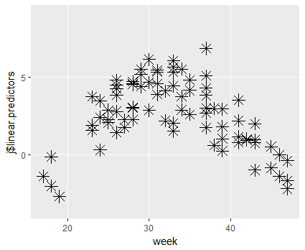
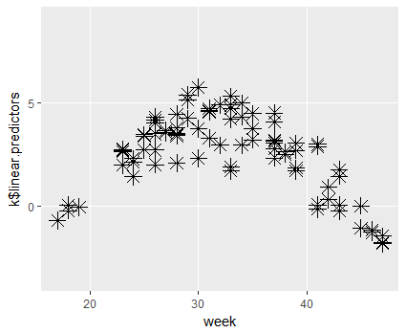
Multiple Regression Estimation Models for Seasonal Variation
Observed V. parahaemolyticus Concentration
Temperature + pH + Saln + Turb
Temperature + Saln
Variation explained = 75.5%
Variation explained = 53.7%

Slide 16
The relative abundance of significant taxa in water and their relatedness:
2011-12
Water microbiome community profiles are ~consistently different between sites with low versus elevated V.p. concentrations.
Notes:
thus, during 2011-12 there were a set of taxa that were present in consistently higher abundance in the day 0 samples than the day 14 samples, while a different set of taxa were present in consistently higher abundance in the day 14 samples than the day 0 samples.

Slide 17
Conclusions
There are an array of environmental conditions that appear to influence V.p. concentrations in oysters.
Some of these probably reflect direct influence and serve as potential indicators and to better understand the ecology of V.p.
Others may be correlative and represent integrated environmental measurements that could potentially serve as indicators of V.p. population dynamics and risk assessment.
Projected warming trends will no doubt change the relative importance of these factors for influencing V.p. concentrations in oysters.
Biological factors (plankton, predators, phage) are probably highly significant influences on V.p. populations once the water temperature is warm during summer.
We are beginning to understand the ecology of pathogenic V.p. strains, including the roles of environmental selection and gene flow.

Slide 18





Acknowledgements
Collaborators:
Spinney Creek Shellfish Inc.
Great Bay National Estuarine Research Reserve-SWM Program
NERACOOS
NH Department of Environmental Services
Piscataqua Regional Estuaries Partnership
UNH Water Resources Research Center
Great Bay Community College
Keene State College

