Slide 1
Conducting Vibrio Illness Investigations and Trace Backs in Massachusetts
National Vibrio parahaemolyticus Workshop
Interstate Shellfish Sanitation Conference
Sheraton Inner Harbor - Baltimore, Maryland
September 6, 2017

Slide 2
Confirmed Vibrio Cases in Massachusetts by Species May 1 – October 31
Data current as of June 8, 2017
Data source: Bureau of Infectious Disease.
Notes:
In recent years MA seen increase in Vp illnesses
Forced us to become pretty adept at conducting illness investigations
In Massachusetts: the majority of what we see is Vibrio parahaemolyticus
Graph includes MA data only from May – October.
Between 2008-2016, 84% of cases, across species, are reported May-October
92% of VP cases occur during these months. (data 2008-2016)

Slide 3
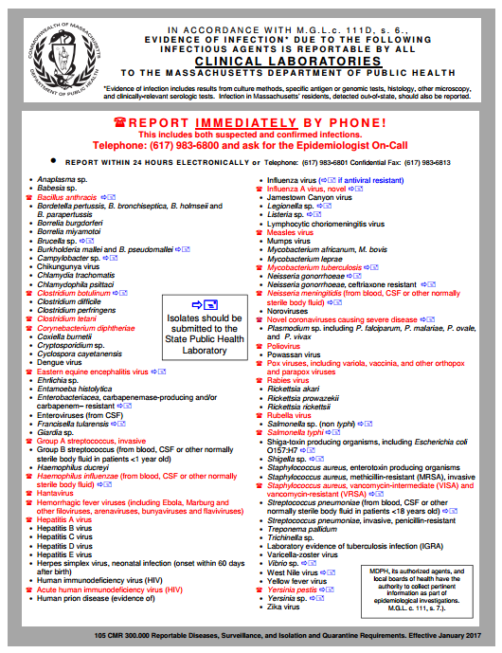
Foodborne Illness Surveillance
A list of notifiable infectious diseases are required to be reported to public health by clinical laboratories and doctors
Includes over 14 foodborne illnesses, as well as any cluster or outbreak of illness
http://www.mass.gov/eohhs/gov/departments/dph/programs/id/epidemiology/rdiq/reporting-diseases-and-surveillance-information.html
Notes:
MA Vibrio Managemant Program begins with illness surveillance:
There is a list of diseases required to be reported to state and local health departments by laboratories and clinicians
This includes Vibrio parahaemolyticus
When a hospital or commercial laboratory identifies a pathogen, they send the bacterial isolate (the bug they found) to the state laboratory who confirms the finding
Every confirmed case is investigated

Slide 4
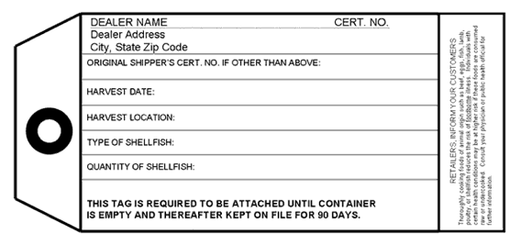
Consumed oysters
Lab-confirmed Vibrio infection identified
DPH Bureau of Infectious Disease notified
Case interviewed
Shellfish tags collected
Retail/wholesale establishment visited
DPH BEH Food Protection Program notified
Division of Marine Fisheries notified
Harvest area/grower visited
Notes:
Let’s walk through how case investigation is shared among these groups.
CLICK 1: The Bureau of Infectious Disease and Laboratory Sciences (Epidemiology Program) is notified of a case when a clinical laboratory reports a positive lab result
CLICK 2: Once Epi is notified, they work with local boards of health (public health nurses) to get the case interviewed within 24 hours
CLICK 3: Often times, Epi learns that a case consumed raw oysters.
CLICK 4: When a suspect food item is identified, Epi notifies the Bureau of Environmental Health Food Protection Program
CLICK 5: FPP inspectional staff, assisted by local boards of health (LBOH), will visit the retail establishment where the oysters were purchased.
The FPP inspectors then continue traceback by visiting the wholesale establishment.
CLICK 6: During the retail inspection, shellfish tags are collected. These tags are required to be kept by retail establishments for 90 days after the product is gone.
FPP and LBOH will review shellfish tags and other shipping records to determine which oysters may be implicated in each illness.
FPP and LBOH will also evaluate retail shellfish handling practices, including time/temperature control of implicated oysters.
FPP then evaluates shellfish handling practices and compliance with MA Vibrio Control Plan by all dealers providing oysters to retail establishments.
CLICK 7: Once tags have been collected, BEH FPP notifies the Division of Marine Fisheries if MA harvest areas are implicated. When specific harvesters are identified, FPP and Department of Fish and Game (DMF) evaluate harvester shellfish handling practices and compliance with MA Vibrio Control Plan.
CLICK 8: DMF visits the harvest area and interviews the grower.
May result in DPH recall of implicated shellfish among wholesale dealers and closure of beds by DMF.

Slide 5
Information
State Agency
Town
Responsibility
Department of Public Health: Bureau of Infectious Disease and Laboratory Sciences
BOH public health nurses
Ill people
Department of Public Health: BEH Food Protection Program
BOH inspectors
Retail & wholesale
Division of Marine Fisheries: Shellfish Sanitation & Management
Local shellfish constables
Harvesters & growing areas
Office of Law Enforcement: Environmental Police
Notes:
Four state agencies involved in case investigation, each with local counterparts and each with our own responsibilities.
In MA municipal or town BOHs license retail establishments such as restaurants and fish markets so there is always some level of local involvement in vibrio investigations
Some BOHs content to let State take the lead, some, like city of Boston, are quite involved and have some aptitude for it

Slide 6
Vibrio parahaemolytics Case Interview
Demographic
Clinical
When did illness begin
Symptoms
Hospitalization
Underlying medical conditions
Exposures before becoming ill
Consumption of high-risk foods
Travel
Close contacts with similar illness
Exposure to water
Provide education
Notes:
Demographic:
Age
Gender
Pre-existing conditions
immunocompromised
Some years up to 60% of pre-existing / immunocompromised

Slide 7
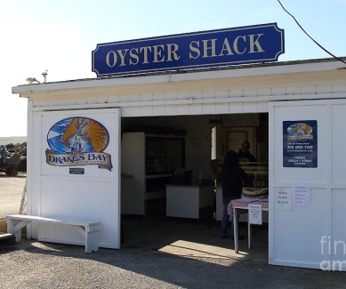
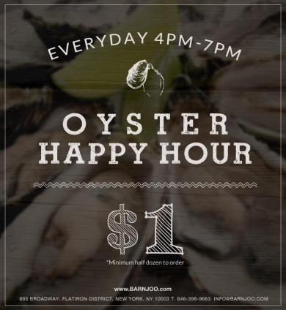
If a Case Reports Eating Oysters
When consumed
Where purchased
Where consumed
Amount consumed
How prepared
Any particular types
Last four digits of credit card used
Notes:
Collect as detailed information during case interview to ensure the traceback is as accurate as possible:
72-hour food history
Specific information
Open-ended questions
Try not to lead the case
Some are not good food historians and occasionally a case is lost to follow-up

Slide 8
Phone Calls
Calls from the public reporting gastrointestinal illness after eating oysters
Symptom and exposure information collected
Individual encouraged to seek medical attention
Complaint is investigated
Without a diagnosis, the illness will not impact the closure of any harvest areas
Notes:
Not a common occurrence, doesn’t usually result in a confirmed illness
In some circumstances it may be considered with other illnesses in a trend or pattern

Slide 9
What Happens With Case Information?
Vibrio Working Group
Established after 2013 season
Modeled after the Working Group on Foodborne Illness Control (1986)
Traceback information across Vp cases is aggregated and discussed among members
Reviews case information and makes decisions as to whether a harvest area closure and/or recall is warranted in accordance with NSSP and state regulations
Work to improve Vibrio investigations
Department of Public Health: Bureau of Infectious Disease
Department of Public Health: Bureau of Environmental Health
Division of Marine Fisheries: Shellfish Sanitation & Management
Office of Law Enforcement: Environmental Police
Notes:
There are a lot of players in Vibrio management. In previous years, was more like a game of telephone where information would be passed from one agency to another. Beginning in 2014, we began meeting as a group twice per month. During these meetings, we discuss new cases under investigation, aggregate traceback information across cases, and discuss whether the volume of cases warrant closure of a harvest area.
Meeting as a group has improved communication and understanding of everyone’s roles and responsibilities
Development of investigation and sampling protocols, job aids for state and local health investigators, and educational materials for industry.

Slide 10
Retail Trace Back and Investigation
Notes:
Conducted in accordance with
CH II of the NSSP Model Ordinance
Guidance documents provided in Section IV of the Guide for the Control of Molluscan Shellfish
MDPH FPP Vibrio Illness Investigation Protocol

Slide 11
2013 FDA Food Code Requirements
Specifications for Receiving
3-202-11 Temperature
3-202.18 Shellstock Identification.
3-202.19 Shellstock, Condition.
Original Containers and Records
3-203.11 Molluscan Shellfish, Original Container.
3-203.12 Shellstock, Maintaining Identification.
Notes:
Retail requirements for handling shellstock
MA currently uses 1999 Food Code but will adopting 2013 in near future
Essentially the same requirements
3-202.11 Requires receiving at 45°F
3-202.18 Tagging Requirements
3-202.19 Dead or excessively muddy shellstock – we know Vibrio is found in sediment
3-203.11 Identification while in storage or on dislplay
3-203.12 Recording date of last shellstock used, retention of tags for 90 days, chronological, approved recordkeeping, prohibits commingling of lots

Slide 12
Properly Identified Containers
Notes:
Original Containers and Records
3-203.11 Molluscan Shellfish, Original Container.
Molluscan shellfish may not be removed from the container in which they are received other than immediately before sale or preparation for service.
Except when displayed on drained ice, or held in a display container and a quantity provided to a consumer if:
(1) The source of the shellstock on display is identified and
(2) The shellstock are protected from contamination.
The same for shucked shellfish
3-203.12 Shellstock, Maintaining Identification.*
Shellstock tags shall remain attached to the container in which the shellstock are received until the container is empty.
Retain shellstock tags or labels for 90 calendar days from the date the container is emptied by:
(a) Using an approved record keeping system that keeps the tags or labels in chronological order correlated to the date when, or dates during which, the shellstock are sold or served; and
(b) If shellstock are removed from their tagged or labeled container:
(1) Using only 1 tagged or labeled container at a time, or
(2) Preserves source identification that shellstock from one tagged or labeled container are not commingled with shellstock from another container before being ordered by the consumer.

Slide 13
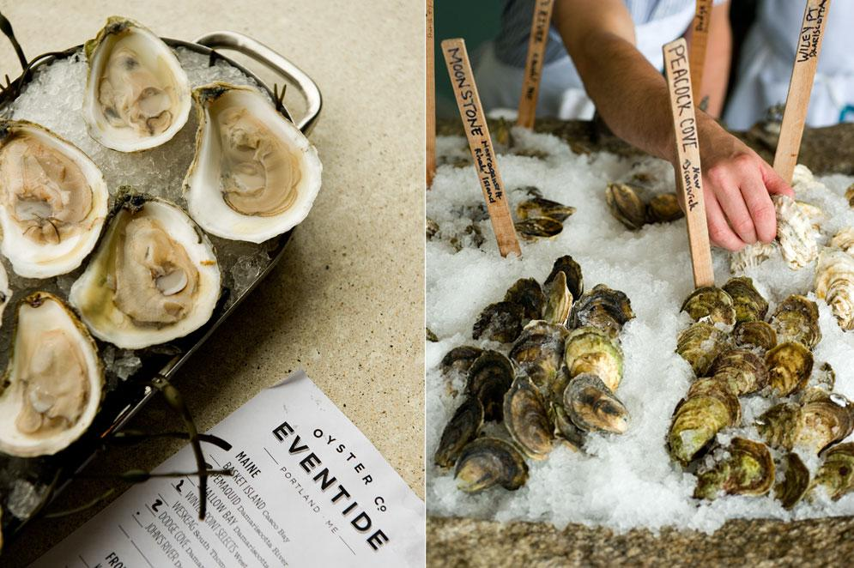
Notes:
Branded oysters and oyster medleys
When at a raw bar, identification signs may be used
When served to the customer, an order slip may accompany a plate
A very helpful practice by restaurants that serve multiple varieties of oysters is, too maintain a daily log of oysters offered that day
Additionally, if the register receipt includes the type of shell fish ordered by the customer, this can be extremely valuable in identifying the source of an implicated oyster.

Slide 14
Approved Source?
Notes:
Direct sale of shellfish by harvesters to retail establishments is prohibited in M, must be a licensed wholesale dealer that meets the requirements of DPH regulations and the NSSP MO.
Some MA harvesters are licensed dealers – fixed facility
Should see an NSSP compliant dealer tag

Slide 15
Date on Back of Tag When Last Oyster Sold
Notes:
Writing the date that the bag was finished helps in the trace-back process. It is required in the 2013 Food Code.
Has been extremely helpful in narrowing down what oysters were on premises and may have been served

Slide 16
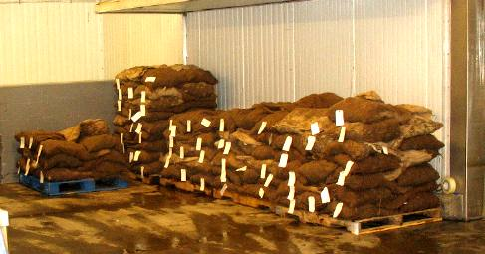
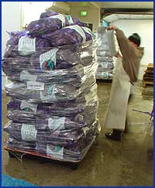
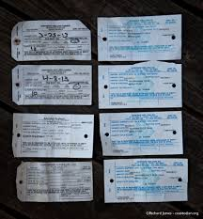
Wholesale Vibrio Traceback
Notes:
Many times there are multiple dealers that require traceback.
We complete them all and it can be demanding on the agencies resources. Investigations often involve multiple fileld and office staff and can take several days to complete.
Information concerning the harvesters is shared with the Division of Marine Fisheries for further investigation.
Traceback at the wholesale dealer facility is determined by the information provided by the foodborne illness coordinator and collected at the retail food establishment.
At the wholesale dealer, we confirm the sales to the retail establishment by BOL’s, shellfish tags, and sales logs.
We also verify the sales of oysters from that lot to the dealers’ receiving log, transaction slips, and harvester tags. We can also determine what other food establishments may have received oysters from a similar lot.

Slide 17
2017 MA Vp Control Plan
Notes:
Each year dealers, who are primary receivers, are provided with the updated MA Vp Control plan. These documents are helpful in conducting the trace-back verification and handling practices.
Additional time/temp controls for harvesters and dealers wh are original shippers
Reviewed by DPH, DMF and MEP on annual basis and modified as needed

Slide 18
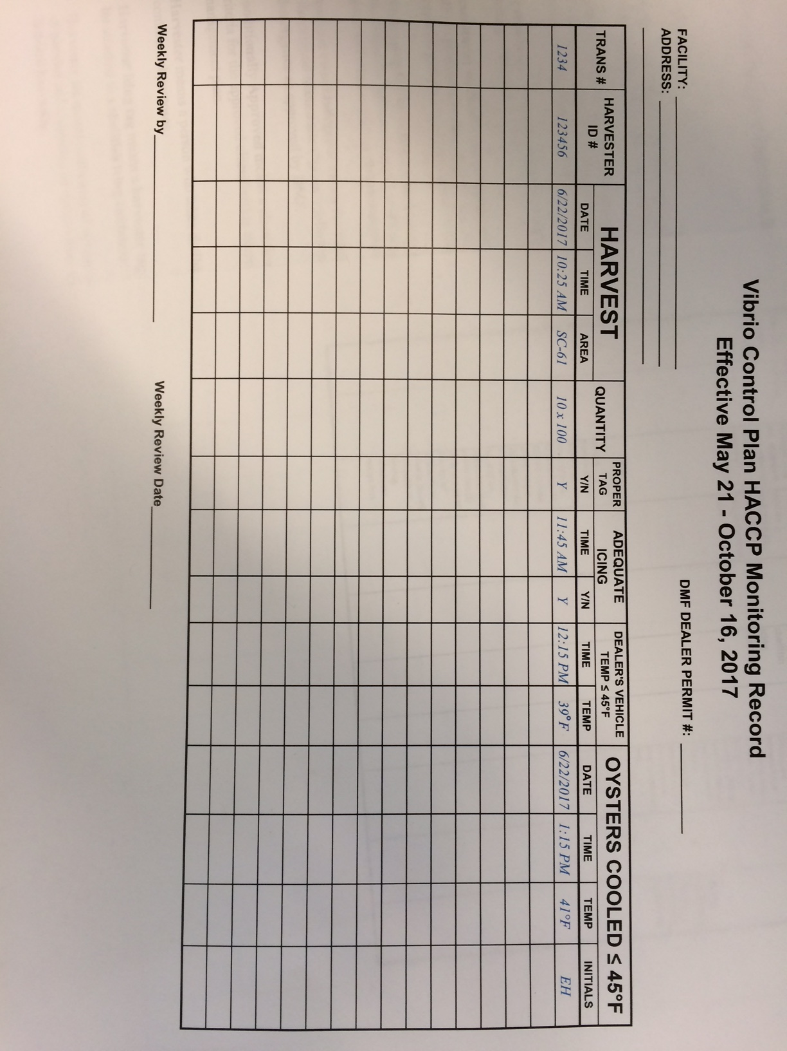
Notes:
The control plan has several monitoring components including properly completed tags, time of harvest, time of icing, time chilled to <45*F, as well as the harvester, date and area.
Additionally, we will look at Shellfish HACCP plans, specifically the oyster HACCP plan for Vibrio season, and the monitoring records during the time in which the oysters were in control by the wholesale dealer. There is a review of cooler logs, thermometer calibration records, daily sanitation records.
A shellfish sanitation inspection will also be conducted to assess the firms safe handling practices.
Firms that participate on the Interstate Shellfish Shippers List are inspected routinely twice per year.

Slide 19
Oyster School 2017
Notes:
What can retail food establishments do to make their oyster handling better? These pearls, there are 4 of them, will make trace-back investigations much easier and demonstrate safe handling while under your control.
Make certain that oysters are from an approved source, that they are tagged properly, and that you retain the tags in an organized manner. One week of tags in a zip locked baggie with the week ending date marked by a sharpie keeps the tags organized. Writing the date on the back of the tag once the bag was emptied and the last oyster sold. Hold these for 90 days.
Record the temperature of the oysters at the time of receipt on a receiving log or the invoice or BOL for each delivery. Receive them covered with ice.
Maintain a cooler log with the time and temperatures recorded twice per day. This lets you know that your cooler is maintaining adequate temperatures during cold storage. Thermometers can be calibrated to 32*F in an ice slurry to verify accuracy weekly. This is a CYA step, when there are illnesses, to demonstrate safe cold storage. A further step would be to routinely ice your oysters and note adequacy of ice on your cooler log.
When multiple brands of oysters are offered by a restaurant, maintain a log of the shellfish varieties offered each day, ie Wellfleets, Duxbury’s, Onset’s, Blue Points, etc. and which one’s may be the “buck-a-shuck” or special.
Retail regulatory requirements for shellfish (food code)
Best Manufacturing Practices
What to expect in the event of a Foodborne Illness Investigation (retail food establishments)
Vibrio parahaemolyticus trace back at retail and at wholesale
Pearls of wisdom

Slide 20
Case Study
Case ate raw oysters (and Chilean sea bass) at 5:30 PM on July 27, 2017 and became ill at 10:00 pm on 7/28/17.
RESTAURANT or EVENT
ADDRESS
Last 4 of cc
# of guests
Other information
Notes:
Once confirmed, case information provided to inspector for investigation.
Coordinates inspection of retail establishment within 24-48 hrs.

Slide 21
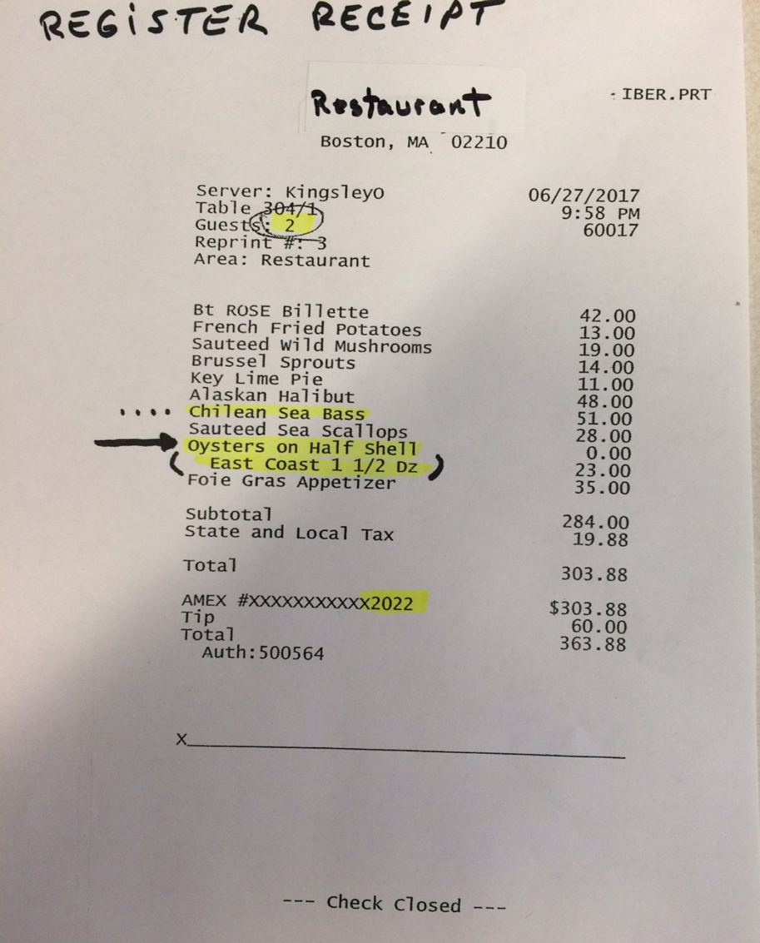
Notes:
We learn at the restaurant that the case had the “East Coast” oysters by the register receipt (this was also included in the EPI history)
In this case we did not have last 4 of credit card numbers to match with receipt, however, we knew the case was a party of two, ate Chilean sea bass and oysters.
There were 4 other receipts, that had this combination, but only one table was a party of two.

Slide 22
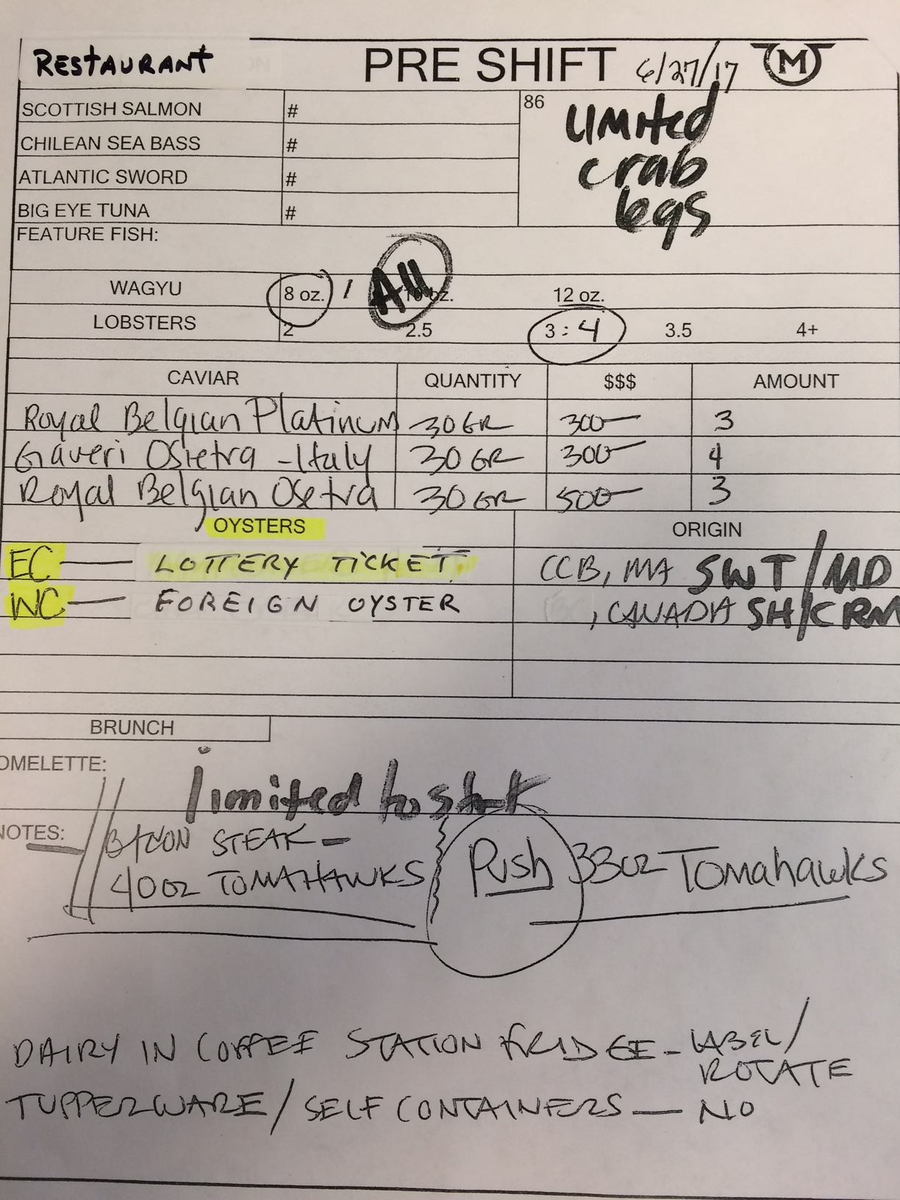
Notes:
Some restaurants have documents that include what oysters were served for that day. In this case, the “east coast” oyster was the Lottery Ticket brand.
Investigators often fail to request this type of document
I’ve had consultants tell me that many restaurants maintain these documents but don’t often provide them unless requested

Slide 23
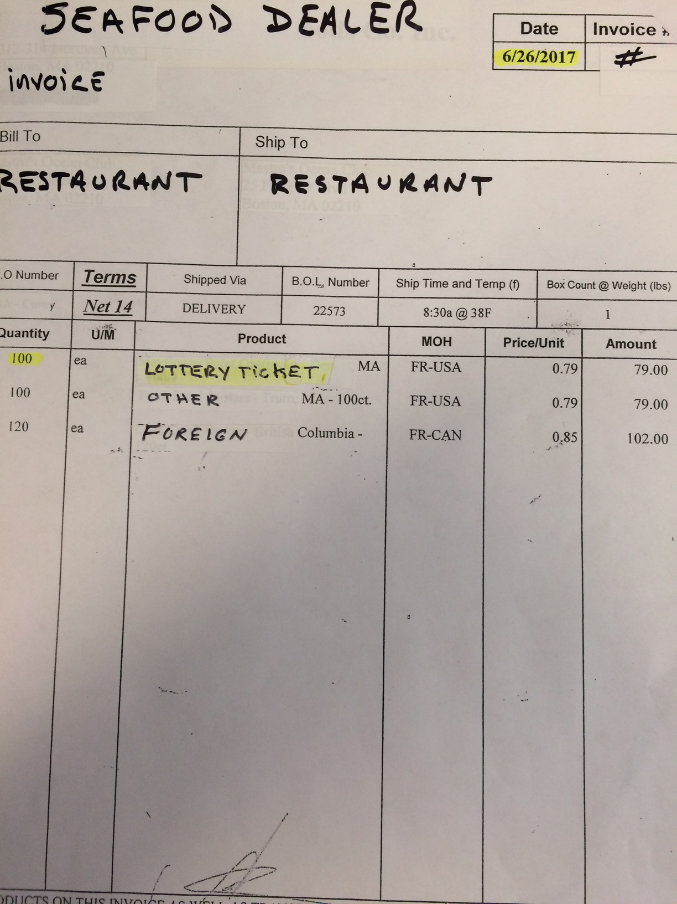
Notes:
One of the most important elements is the dealer bill of lading or invoice that accompanies the shellfish when delivered.
Often this will include the lot #’s, harvest dates, and harvest areas.
Knowing the sales data, the frequency of deliveries, who the suppliers are, will help narrow the search.

Slide 24
Notes:
Review the shellfish tags and compare these with the invoices.
Do shipping dates match up?
Can eliminate specific lots or shipments at by comparing – both at retail and wholesale

Slide 25
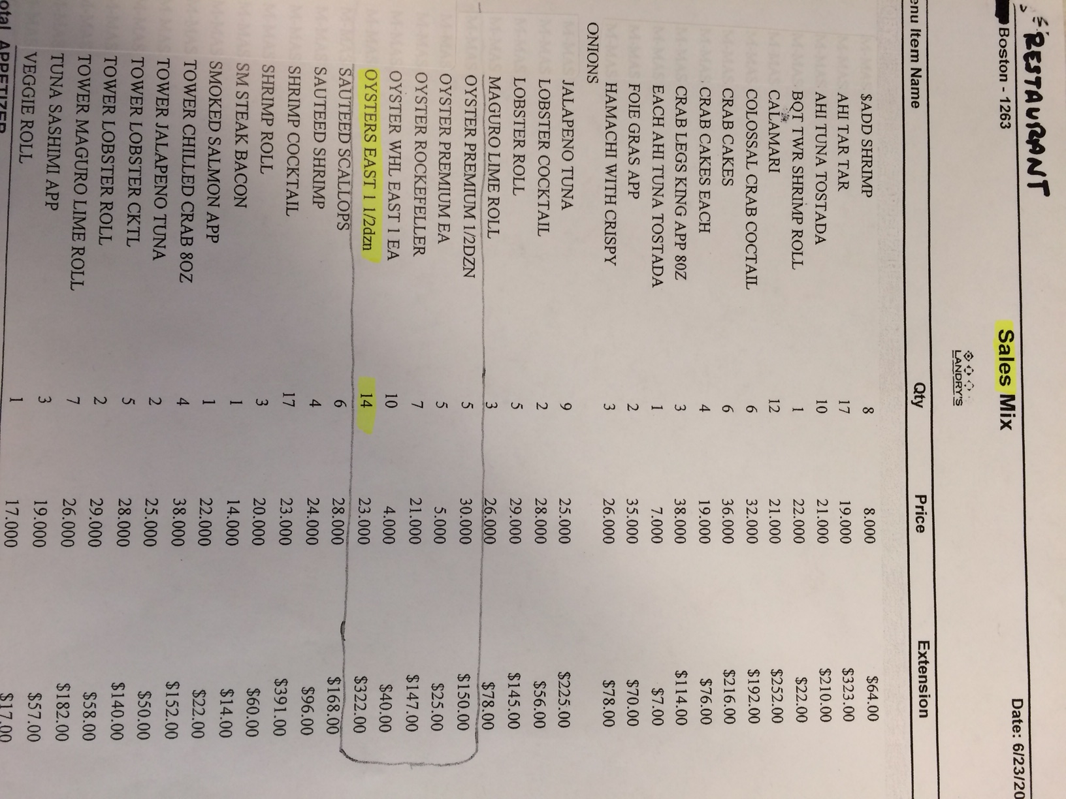
Notes:
A review of the establishments menu will indicate how shellfish is used; oysters may be served in the ½ shell, by the each, half-dozen, dozen, in a cocktail, on a chilled seafood sampler / tower, or used as a cooked item, such as oysters Rockefeller.
A look at sales data (many restaurants have this information) can be done to verify sales of shellfish. All of these may factor in how fast a restaurant goes through inventory. It is the raw oyster that may cause the Vp illness.
All of this information will point will implicate one or more lots of oysters that the case consumed. We use this information to take us to the wholesale dealers.

Slide 26
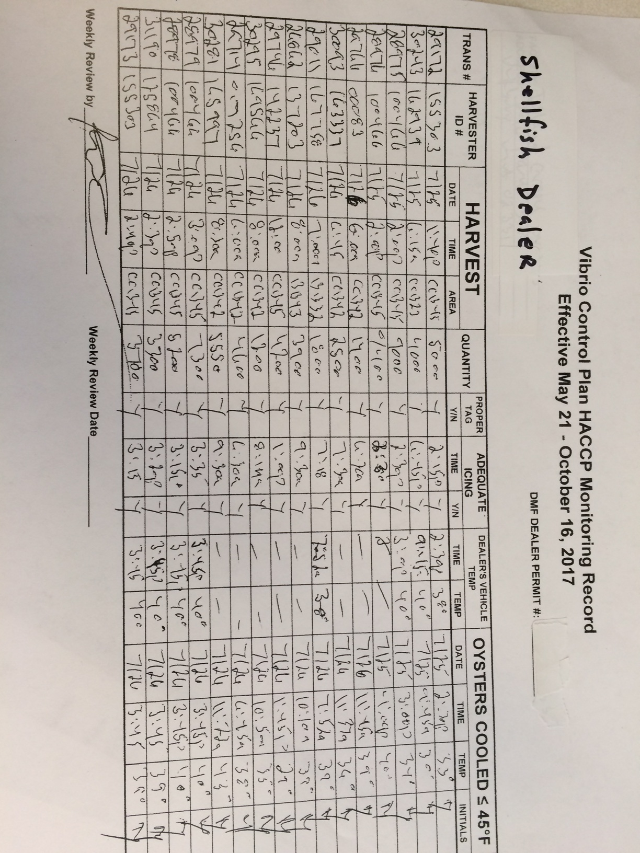
Notes:
Once we have narrowed down the investigation, we conduct a similar investigation at the wholesale dealer facility, looking at invoices, receiving and sales logs, Vibrio Control Monitoring logs, transaction slips, harvester tags, cooler logs.
In MA, we have a Vibrio parahaemolyticus control plan that must be followed by harvesters and dealers to help mitigate the incidence of illnesses.
Additional important information, such as time of harvest, time of icing, time the shellfish was chilled to <45*F within ten hours took place will be on the harvester tag or dealer Vp control log.

Slide 27
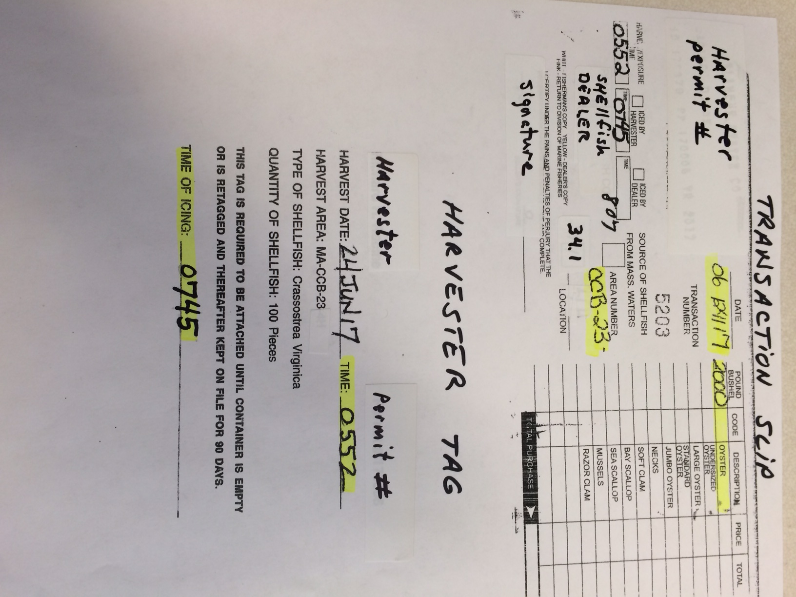
Notes:
We also look at Transaction slips and harvester tags. This information will confirm the harvest area, date, and harvester.
We pass the information along to the Division of Marine Fisheries, where further investigation is carried on to the water side of shellfish handling, to ensure that handling practices are being conducted adequately by the shell fishermen.

Slide 28
Eric M. Hickey MA DPH Food Protection Program eric.hickey@state.ma.us

