Slide 1
ISSC, VARB & Other Vp Research
Jessica L. Jones, Ph.D.
FDA
Gulf Coast Seafood Laboratory
Dauphin Island, Alabama

Slide 2
NY/CT Reopening
Vibrio levels higher in oysters than clams from the same harvest area.

Slide 3
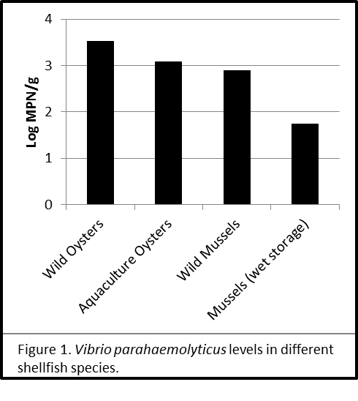
SC Vibrio Levels in Summer
Vibrio levels differ based on shellfish type/storage condition.

Slide 4

AL Resubmerging (Aquaculture)
Vibrio levels return to background after 14d resubmerging following routine desiccation.

Slide 5

Auburn Univ. Resubmerging
Variation was seen amongst the trials, but Vibrio levels returned to background after 7d of resubmergence.

Slide 6

WA Intertidal
Regardless of container, vibrio levels returned to background after one tidal cycle.

Slide 7
NJ Intertidal
Vibrio levels returned to background after the second day, following an initial increase post-sorting.

Slide 8
AL Handling Practices
Vibrio levels increased after 5h of ambient storage, especially under refrigeration compared to ice slurry.

Slide 9

NJ Handling Practices
Vibrio levels increased after 5h and 7h of shaded storage.

Slide 10

NJ Handling Practices
After 5h of ambient exposure, Vibrio levels increase, more so with mechanical refrigeration.

Slide 11
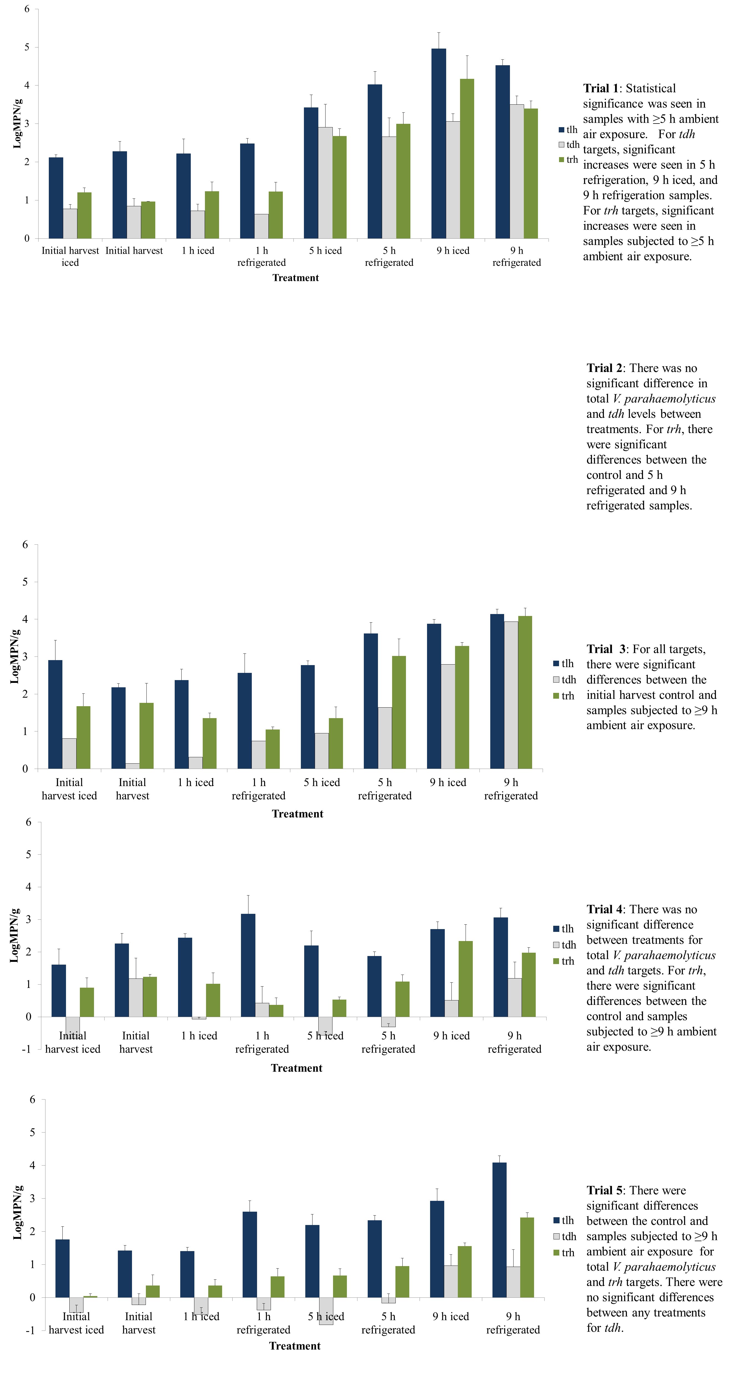

WA Handling Practices
Variation was seen amongst trials, but 5h refrigerated and both 9h treatments showed increased Vibrio levels.

Slide 12
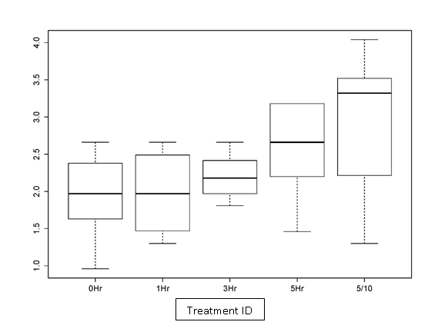
CT Handling Practices
After 5h ambient exposure, Vibrio levels increased significantly.

Slide 13
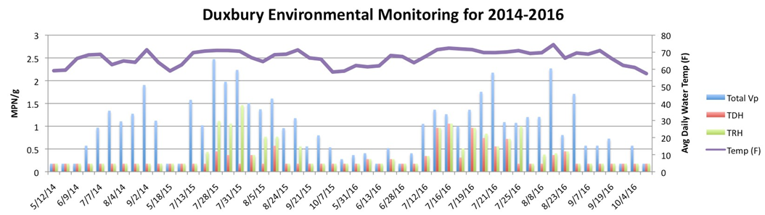
Duxbury Bay, MA
total: 85/114; 21.5±5.1 log MPN/g
tdh: 26/113; 5.0±1.9 log MPN/g
trh: 40/113; 7.8±2.9 log MPN/g

Slide 14
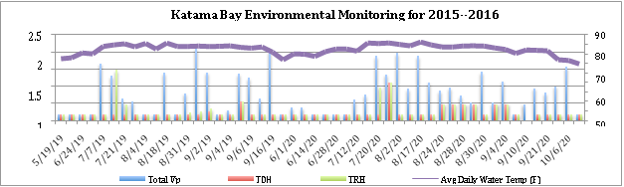
Katama Bay, MA
total: 75/104; 23.6±12.6 log MPN/g
tdh: 19/100; 28.2±51.2 log MPN/g
trh: 25/98; 20.2±37.7 log MPN/g

Slide 15
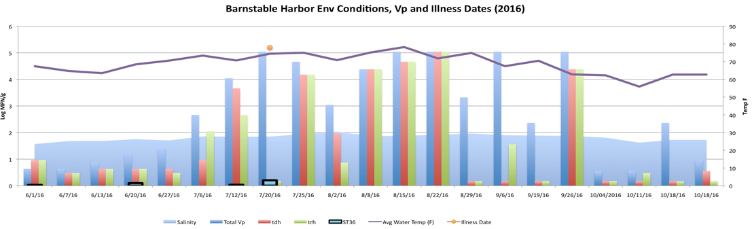
Barnstable Harbor, MA
total: 20/29; 100.0±11.0 log MPN/g
tdh: 5/29; 23.6±19.5 log MPN/g
trh: 6/21; 28.8±7.3 log MPN/g

Slide 16
Massachusetts
 | Total Vp |  |  |  | tdh |  |  |  | trh
 | MA | D | K | B | MA | D | K | B | MA | D | K | B
Temp. | + | + | + | + | + | + | none | none | + | + | + | none
Sal. | none | + | none | + | none | none | none | none | none | none | none | none
Depth | - | - | none | none | none | none | none | none | - | none | none | none
pH | - | none | none | none | none | none | none | none | none | none | none | none
Turb. | none | none | none | none | none | none | none | none | none | none | none | none
Chl. | + | + | none | none | none | + | none | none | + | + | none | none
Correlations with environmental parameters is dependent on specific harvest location.

Slide 17
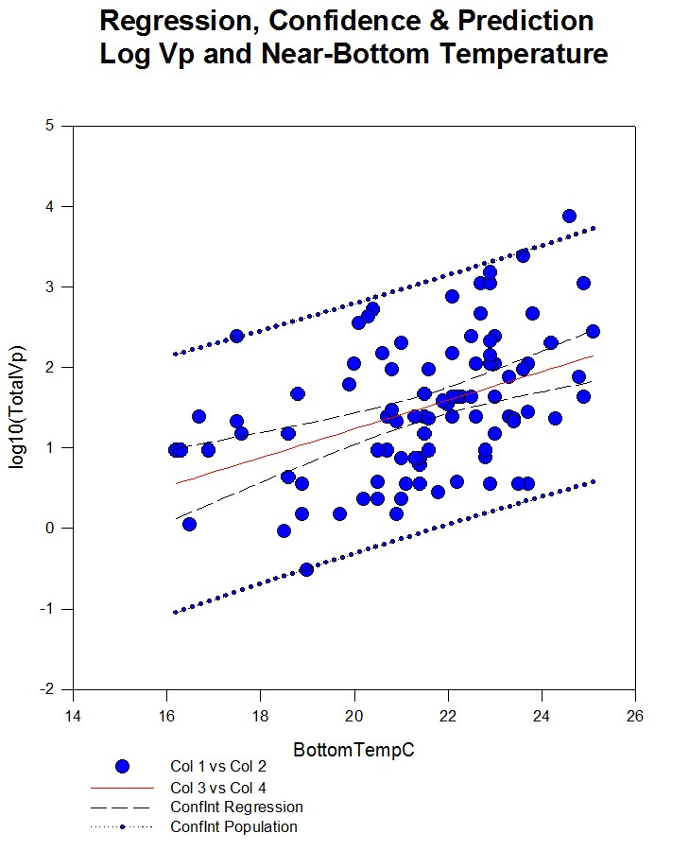
In CT, bottom temperature and Vp levels show a strong correlation.

Slide 18
WA Substrate Study
A seasonal difference was noted, but also harder substrates had higher levels of Vibrio.

Slide 19
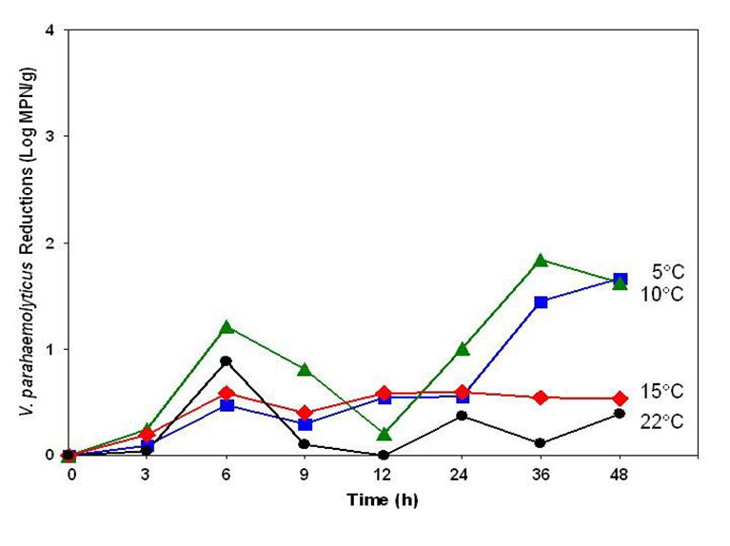
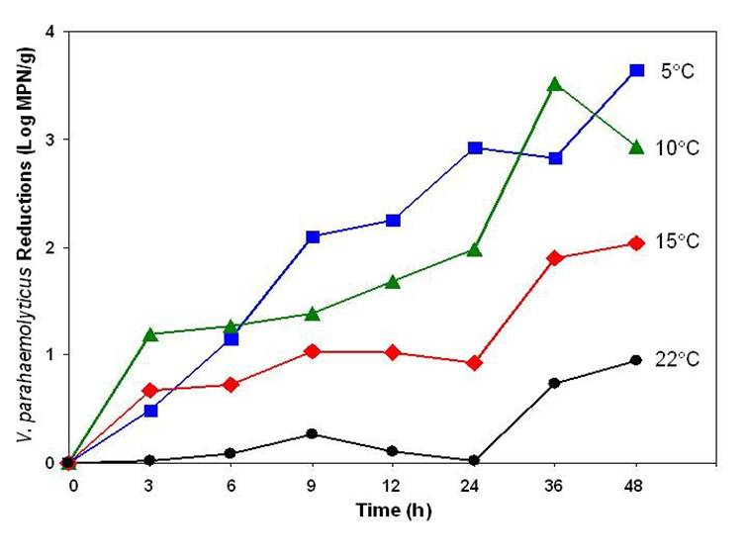
WA “Depuration”
Temperature affects purging in ASW, but not with EO water.

Slide 20
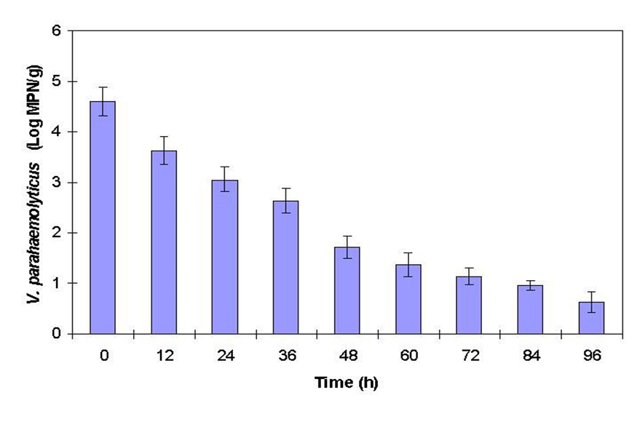
WA “Depuration”
Naturally contaminated oysters in ASW at 5˚C reduce Vp levels ~3 logs in 3 days.

Slide 21
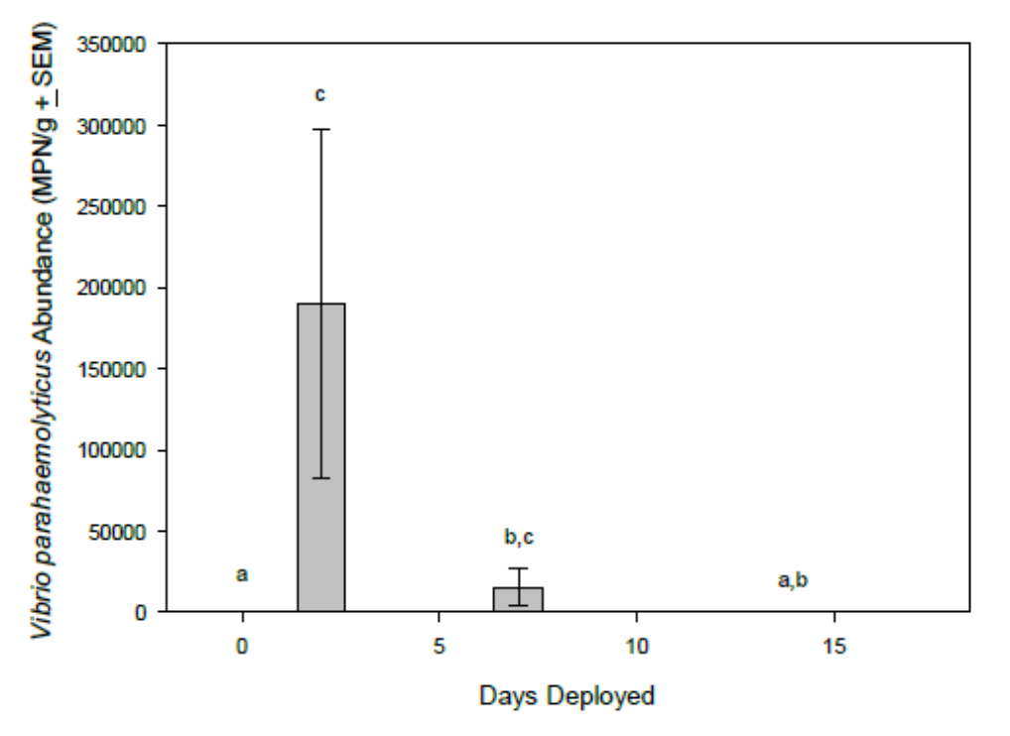


AL “Relaying” for Vibrio Reduction
After an increase in Vibrio levels upon initial re-submergence, Vibrio decreased after 7 days.

Slide 22
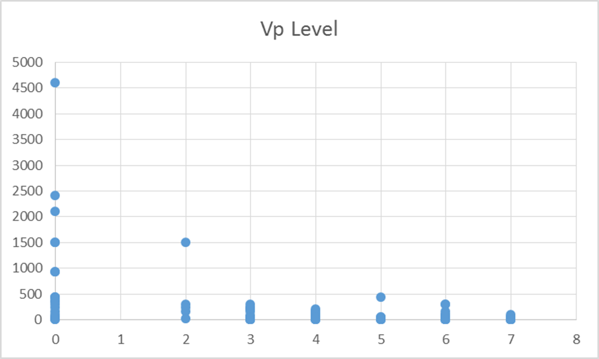
WA Deep Water Purging
Cold, deep water purging shows promise for reducing Vibrio levels.

Slide 25
Johnson et al 2012

Slide 28
VARB
Developed in 2014 to address the need to standardize how FDA responds to external requests for assistance
Does not apply to internal requests which require only minimal CFSAN resources
This process is also not intended to supersede FDA’s ability and willingness to respond to emergency situations and requests that arise due too such emergencies

Slide 29
VARB Process
States submit requests via their Specialist to CFSAN (Stacey Degrasse, Chair)
Requests can be submitted at any time, but cut off dates for quarterly review meetings are:
  March 31
  June 30
  September 30
  December 31

Slide 30
VARB Process (con’t)
Submissions ranked at quarterly meetings based on specific evaluation criteria:
  Programmatic impact
  FDA capability and capacity
  Requestor capability and capacity
  Leveraged resources of requestor
  Sustainability
Final rankings, decision to support, along with specific feedback are provided to requestors and ISSC

Slide 31
F14-WA-02: Icing Study
Triplicate samples collected from eight treatments
  Immediately ice - Initial harvest
  1h ambient, then iced - 1h refrigerated
  5h ambient, then iced - 5h refrigerated
  9h ambient, then iced - 9h refrigerated
Experiment replicated five times between Jul 1- Aug 29

Slide 32
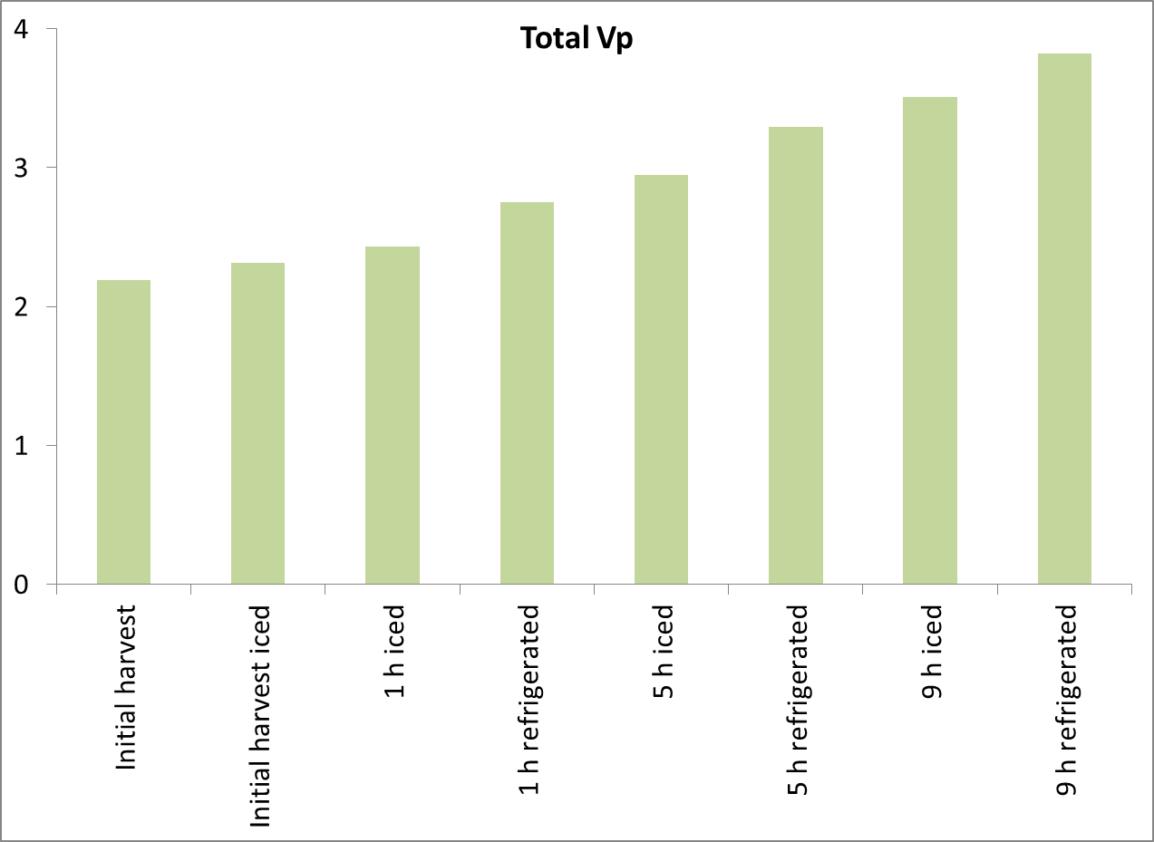
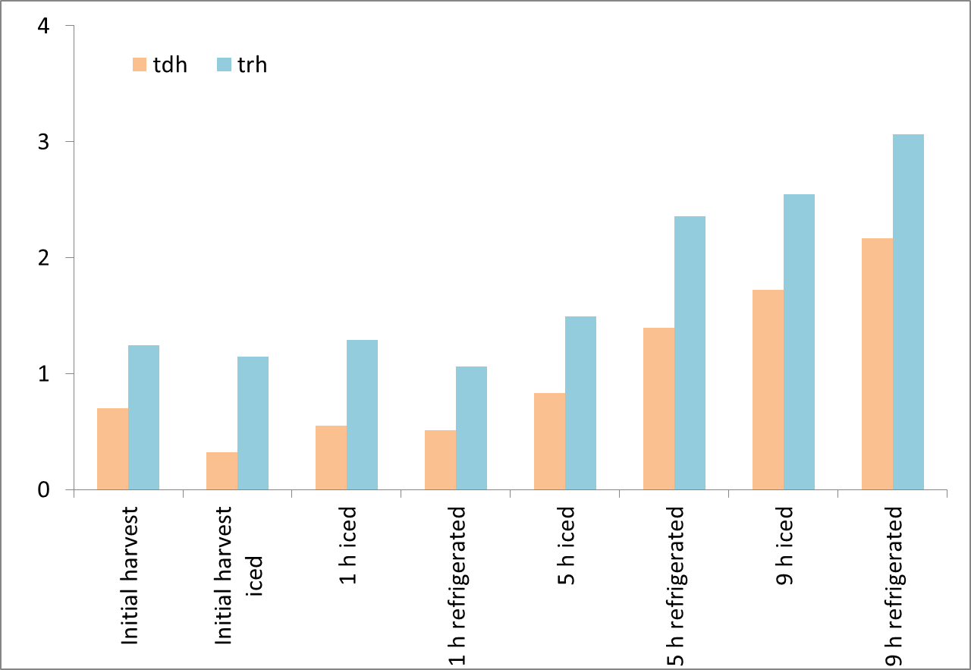
F14-WA-02:Preliminary Results

Slide 33
ISSC - MA
2014-2016 weekly collection data
Intertidial collection within 1h of exposure
Stored on ice, analyzed same day or next
Method: NSSP (MPN-PCR) for total, tdh, trh
Samples with temp abuse in transit omitted; <3 considered negative

Slide 34
ISSC - WA
Influence of shellfish bed substrate on rate of growth of Vibrio parahaemolyticus in oysters h
2015-2016, V. parahaemolyticus concentrations were analyzed in oysters harvested from three different substrate types rocky (gravel), muddy and a mixture of sand and mud (regular) within each growing area harvested from Washington State.
Oakland Bay, Samish Bay and Hood Canal 5
Method: WA MPN-PCR for total, tdh???

Slide 35
ISSC - WA
Influence of shellfish bed substrate on rate of growth of Vibrio parahaemolyticus in oysters h
2015-2016, V. parahaemolyticus concentrations were analyzed in oysters harvested from three different substrate types rocky (gravel), muddy and a mixture of sand and mud (regular) within each growing area harvested from Washington State.
Oakland Bay, Samish Bay and Hood Canal 5
Method: WA MPN-PCR for total, tdh???

Slide 36
Wa
Laboratory assessment of the relation between water temperature, immersion time and exposure to bactericidal oxidation products on Vibrio parahaemolyticus levels in Pacific oysters
5 strain cocktail; BAM MPN-culture (no confirmation)
Ren T, Su Y-C. 2006. Effects of electrolyzed oxidizing water on reducing Vibrio parahaemolyticus and Vibrio vulnificus in raw oysters. J. Food Prot. 69:1829-1834.

Slide 37
ISSC – CT (2016)
Techniques and Practices for Vibrio Reduction: Connecticut
Methods: NSSP for total, tdh, trh
1) Zero (0) Hour (Baseline): Immediate post-harvest rapid cooling to internal temperature of 50°F (10°C) or less using ice slurry, and
2) One (1) hour from harvest to internal temperature of 50°F (10°C) or less using ice slurry (45 minutes on deck then into slurry for 15 minutes rapid cooling), and
3) Three (3) hours from harvest to internal temperature of 50°F (10°C) or less using ice slurry (two (2) hours 45 minutes on deck prior to slurry for 15 minutes), and
4) Five (5) hours from harvest to internal temperature of 50°F (10°C) or less using ice slurry (four (4) hours 45 minutes on deck prior to slurry for 15 minutes), and
5) NSSP standard VPCP: Five (5) hours from harvest into mechanical refrigeration at or below 45°F (7.2°C) and maximum of ten (10) hours to an internal temperature of 50°F (10°C).

Slide 38
Diff between mechaical refrig and ice slurry w/in 1 and 3 h
Group Name | N | Mean | Std Dev | SEM
0Hr | 13 | 1.908 | 0.51 | 0.141
1Hr | 7 | 1.98 | 0.585 | 0.221
3Hr | 7 | 2.201 | 0.308 | 0.117
5Hr | 13 | 2.581 | 0.582 | 0.162
5/10 | 11 | 2.918 | 0.924 | 0.279

Slide 39
All Pairwise Multiple Comparison Procedures (Fisher LSD Method):
 | Comparisons for factor: Process Study Code
Comparison | Diff of Means | LSD(alpha=0.050) | P | Diff >= LSD
5/10 vs. 0Hr | 1.01 | 0.521 | <0.001 | Yes
5/10 vs. 1Hr | 0.938 | 0.615 | 0.004 | Yes
5/10 vs. 3Hr | 0.717 | 0.615 | 0.023 | Yes
5/10 vs. 5Hr | 0.337 | 0.521 | 0.199 | No
5Hr vs. 0Hr | 0.673 | 0.499 | 0.009 | Yes
5Hr vs. 1Hr | 0.601 | 0.596 | 0.048 | Yes
5Hr vs. 3Hr | 0.38 | 0.596 | 0.206 | No
3Hr vs. 0Hr | 0.294 | 0.596 | 0.327 | No
3Hr vs. 1Hr | 0.222 | 0.68 | 0.515 | Do Not Test
1Hr vs. 0Hr | 0.072 | 0.596 | 0.809 | Do Not Test

Slide 40
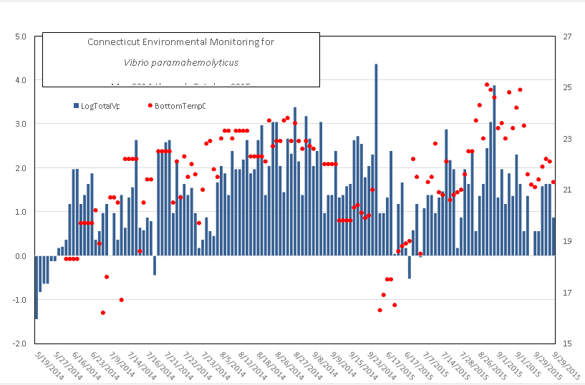

Slide 41
ISSC – AL (2012)
Test of Effectiveness of Relaying as a Post Harvest Process for reducing levels of Vibrio vulnificus and V. parahaemolyticus in Shellstock Oysters
Immediate harvest, refrigerated within one hour (white tag), unrefrigerated (green tag) until landing
Methods: BAM MPN-culture (gene probe)

Slide 42
Day | Sandy Bay |  | Dauphin Island
 | Temp (ºC) | Salinity (PSU) | Temp (ºC) | Salinity (PSU)
August Run
2 | 29.1 | 25.3 | 30.2 | 22.6
7 | 29.8 | 26.9 | 30.8 | 27.6
14 | 28.2 | 27.5 | 30.2 | 29.0
Sept. Run
2 | 28.5 | 21.2 | 27.1 | 27.8
7 | 26.8 | 22.3 | 27.4 | 26.8
14 | 22.6 | 23.7 | 21.6 | 22.1

Slide 43
 |  | V. vulnificus (+ SD) | V. parahaemolyticus (+ SD)
Immediately Iced (t0) |  | 11,240 (+ 6,562) | 318 (+ 308)
White Tagged (t0WT) |  | 11,730 (+ 10,734) | 1,066 (+ 1,391)
Green Tagged (t0GT) |  | 67,600 (+ 42,426) | 3,761 (+ 3,785)

Slide 44
ISSC – PSI (2017)
Techniques and Practices for Vibrio Reduction
2014-2016
Methods: BAM (AmTest Laboratories) for total

Slide 45
ISSC – NJ (2015)
Techniques and Practices for Vibrio Reduction – Use of Shading and Rapid Cooling (ice slurry) to Control Vibrio Growth
Methods: NSSP, but LC480 total, tdh, trh
A | Collect 15 -20 oysters, immediately place on ice, transport, shuck, and analyze. Do during weeks of (05/18/15, 06/15/15, 06/22/15, 07/13/15, and 08/17/15). Lab processes on arrival during those weeks!
N | Baseline/Zero Hour: Immediate rapid cooling of 15 – 20 harvested oysters for 10 minutes to meat temperature of 10°C or 50° F or less using ice slurry! Take shell & meat temps after slurry. Place on ice after slurry. Lab processes on arrival.
O | 1 hour from harvest of 15 – 20 oysters to meat temperature of 10°C or 50° F or less using ice slurry (50 min on deck in shade then into slurry for 10 minutes rapid cooling)! Take shell and meat temps. after slurry. Place on ice after slurry. Lab processes on arrival.
P | 3 hours from harvest of 15 – 20 oysters to meat temperature of 10°C or 50° F or less using ice slurry (2 hours 50 min on deck in shade then into slurry for 10 minutes rapid cooling)! Field crew/lab take shell and meat temps after slurry on P, as slurry might be done at lab! Collect and keep shaded for 2 hours and 50 minutes only; then place in slurry, and if needed, follow w/ ice. Lab processes on arrival or after slurry.
Q | 5 hours from harvest of 15 – 20 oysters to meat temperature of 10°C or 50° F or less using ice slurry (4 hours 50 min on deck in shade then into slurry for 10 minutes rapid cooling)! Field crew/lab take shell and meat temps after slurry on Q, as slurry likely done at lab. Collect and keep shaded for 4 hours and 50 minutes only, then place in slurry, and if needed, follow w/ ice. Lab processes on arrival or after slurry process at lab.
R | NSSP standard VPCP: Shade 15 – 20 oysters for 5 hours from harvest then into traditional mechanical temperature control for 10 hours to an internal temperature of 10° C or 50° F. Lab takes shaded product, places in refrigerator for 10 hours of cooling and then lab takes pre-process shell and meat temperature and processes next day!

Slide 48
Taylor Shellfish
Our methods were straight forward and simple. Identify oysters with elevated levels during vibrio season, relay them in to growing trays stocked at grow out densities and hang them below rafts in water deep enough to reach the 12 – 15 C range while sampling at intervals to measure the changes in Vp levels.
Methods: ??

Slide 49
Apparent reduction across board, with all lots meeting then Canadian standards (n=5 sampling with only 1 result >100 MPN) for oysters intended for raw consumption.
Some lot samples showed a low Zero hour and then suggested an increase over the first few days, but this is likely an indication of inadequate sampling at the zero hour and/or the inconsistency in Vp loads at the zero hour. Regardless of zero-hour levels all lots showed a significant reduction by day 7.

Slide 50
Points of contact
Dr. Stacey Degrasse, VARB Chair
  Stacey.Degrasse@fda.hhs.gov
Dr. Jessica Jones, VARB Vice-Chair
  Jessica.Jones@fda.hhs.gov

