Slide 1
US Oyster Production
Notes:
NOAA tools, EFR. Hab’s

Slide 2
Production Data….
NMFS Commercial Fisheries Statistics dataset 2000- 2015
Many caveats…..
Select states to get a feel for trends in production
Monthly data from MA and NJ from ISSC
Do production trends provide any insight into Vp illness trends?

Slide 3
Total Oyster Production 2008 - 2014

Slide 4
Washington State

Slide 5
Texas

Slide 6
Louisiana

Slide 7
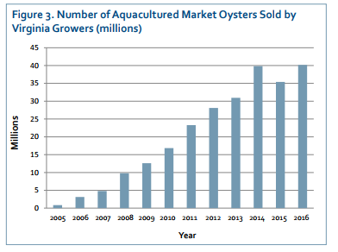
Virginia
NMFS
VIMS Marine Resource Report No. 2017-7, May 2017

Slide 8
Massachusetts
NMFS
MA DMF

Slide 9
Massachusetts
MA DMF

Slide 10
New Jersey
NJ DFW

Slide 11
Summary
WA
TX
LA
VA
NJ
MA
WA and LA top producing states with relatively consistent production.
Texas more variable, decline in recent years?
Increasing production in VA, MA and to a lesser extent NJ.
Need more complete data….

