Slide 1
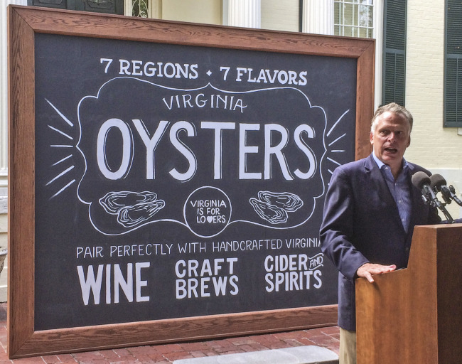
Virginia’s Vp Control Plan

Slide 2
Virginia Vp Control Plan
Governor’s news release November 10, 2015:
"Over the past 11 years, the oyster harvest in Virginia has increased from 24,000 bushels in 2003 to an estimated 659,000 bushels last year"

Slide 3
1) Describe any strain or environmental data that your State has developed for assessing risks.
VA labs have not routinely perform PFGE on clinical Vp isolates
Though we do environmental monitoring for Vp, the data are limited and we do not use it in our risk assessment.
Risk assessments use the FDA/ISSC risk model based on air/water temperatures.

Slide 4
2) Describe the Vp Control Plan in your State. General Concepts:
The Vibrio plan is a joint assessment of Vp as well as Vv.
Controls are in place from May 1 – October 31
Most of our harvest is subtidal, but because of the shallow nature of many areas, some harvesters must work on tides. Controls based on curfew times alone were not practical.
The Vv controls tend to be more strict, and as such drive the controls in use.

Slide 5
3) Pre-harvest controls.
Harvesters have four options to choose from:
1) Curfews. Harvest must be landed and under refrigeration by:
May 1 - May 31: 11am
June 1 – August 31: 10am
September 1 – September 30: 12pm
* All controls other than curfews require additional permits.

Slide 6
3) Pre-harvest controls. (continued)
2) On-board icing/refrigeration. Harvesters must continuously ice/refrigerate for the duration of harvest.
3) Dock-to-temperature control time limits with GPS tracking. Harvesters must carry a GPS timing device during harvest, and have their catch under temperature control by: May-5 hours; June-3 hours; July-August 2 hours

Slide 7
3) Pre-harvest controls. (continued)
4) Labeling For Shucking or PHP Only”
The regulation requires that a Certified VA Shucker-Packer obtain the permit and shuck all green tagged product. VA regulations do not allow the product to be shipped into interstate commerce with a green tag.

Slide 8
3) Post-harvest controls.
Cool to 55º F within 5 hours
- The majority of oysters are iced starting on the boat.
- Some use mechanical refrigeration, a few use the ice slurry method
- HACCP recordkeeping is required to document cooling times

Slide 9
4. Share your assessment of the effectiveness of each control and provide rationale for your conclusions.
in 2004, our oyster harvest levels were around 20K bushels.
in 2016 we were at around 700k
We have maintained single-source cases in the single digits throughout this time.

Slide 10
5. Assess industry compliance in your State.
Not perfect, but very good. VMRC estimates 85-90 % compliance with harvest controls.
Steadily improving. in 2013 VMRC issued 9 citations for WWHR violations, and the number has decreased each year since.
in 2016, only 1 citation was issued.
Dealer compliance: in 2016 our audit found 98% compliance with post-harvest controls.

