Slide 1
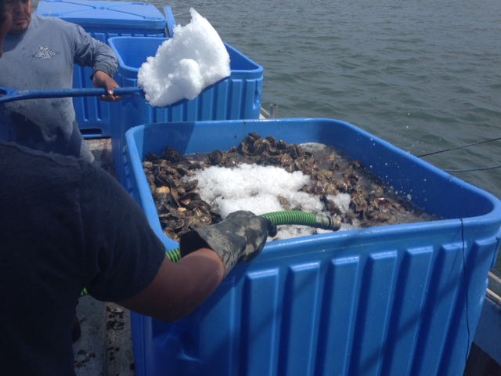
Connecticut Vibrio parahaemolyticus Update 2017
Kristin DeRosia-Banick
Environmental Analyst 3
Connecticut Department of Agriculture Bureau of Aquaculture

Slide 2
CT Industry Overview
41 harvesters licensed as Shellstock Shippers operating under HACCP plans for harvest, storage, and receiving of shellstock
Mercenaria mercenaria (hard clam) and Crassostrea virginica (eastern oyster) harvest
Harvest methods:
Hydraulic harvest of hard clams
Traditional bottom cultivation of oysters
Aquaculture cage production of oysters
All subtidal harvest for oysters: generally 10-30 feet depth at MLW
24 oyster producers operating under VPCP in 2017

Slide 3
Pre-Harvest Controls
Traditional Bottom Culture:
Pre-culling/sorting of oysters prior to placing on bottom to minimize exposure on vessel (will be mandatory in 2018 VPCP)
Aquaculture Cultivation:
Pre-culling of oysters in cages to minimize exposure at time of harvest
Re-submergence controls will be mandatory in 2018 VPCP

Slide 4
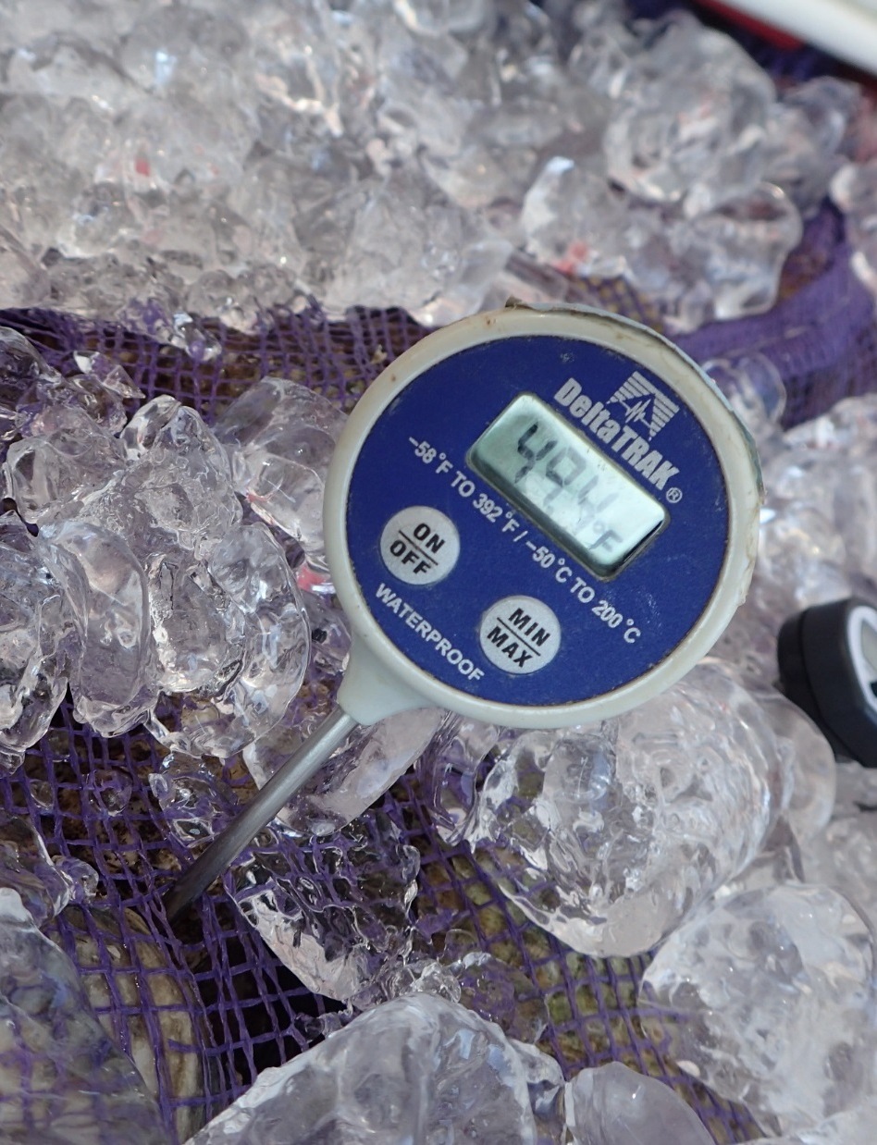
2017 Vibrio parahaemolyticus Control Plans (VPCP)
Two control plans in place: one for 2013 outbreak area and one for the rest of CT growing areas
Vp Control Plans in CT apply to Oysters Only (only sporadic cases linked to Hard Clams in CT)
Rapid Cooling VPCP (2013 outbreak area): required the rapid cooling of oysters harvested from the waters of Norwalk, Westport and Darien to an internal temperature of 50°F within one hour of harvest from June 1 though September 30, when water temperatures are above 68°F; shading
General CT VPCP: 5 hours from harvest to refrigeration and 5 hours to cool to internal temperature of 50°F from June 1 through September 30; shading

Slide 5
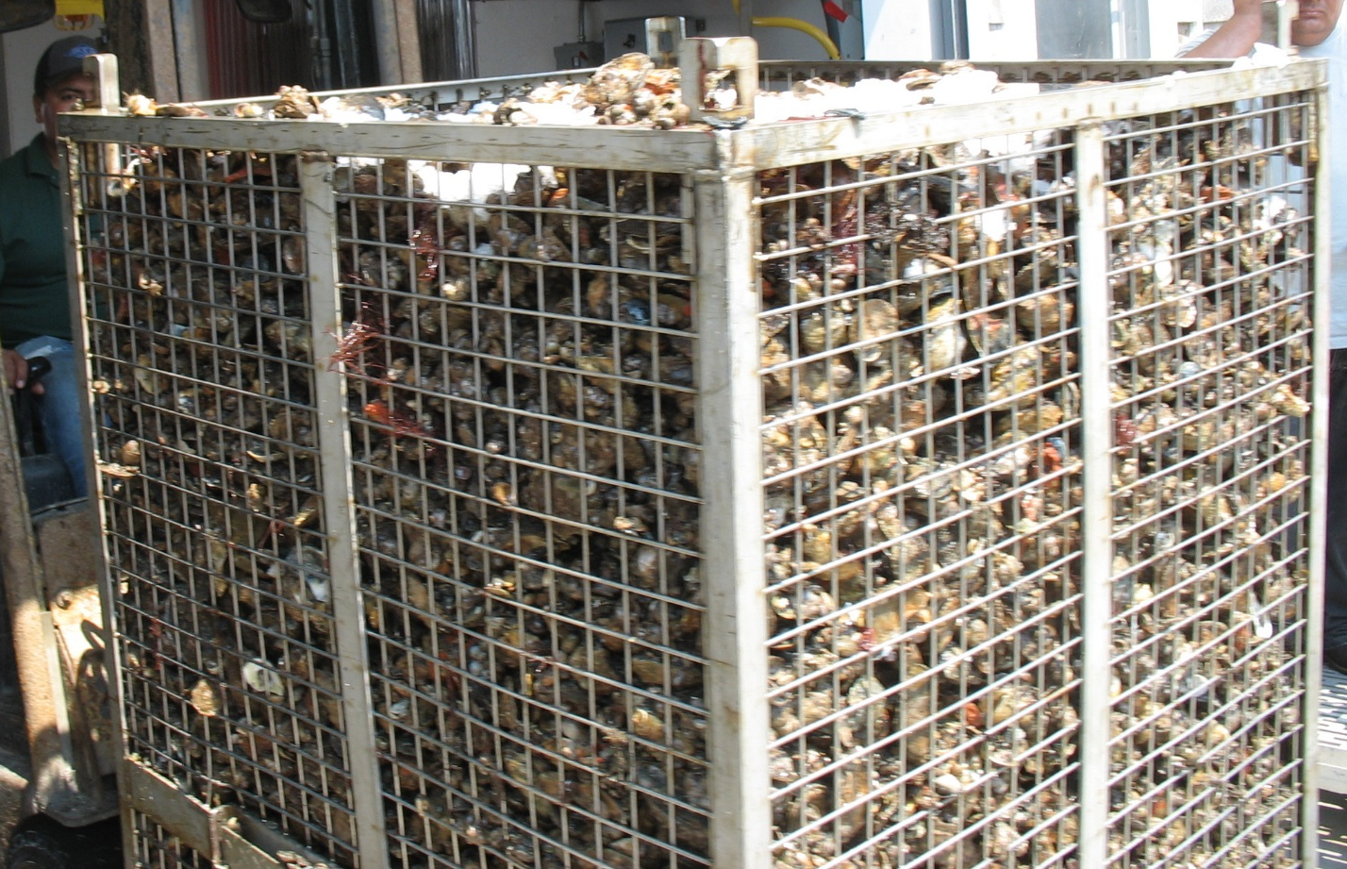
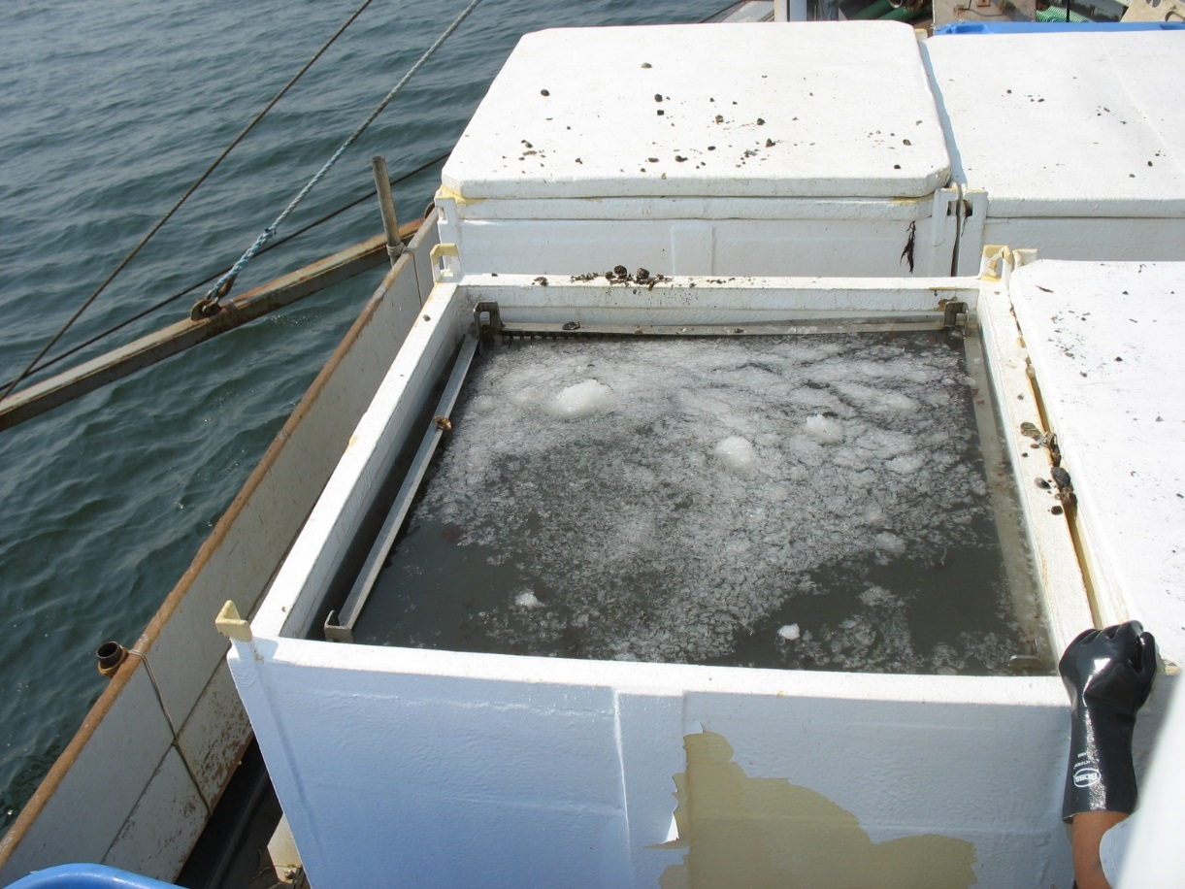
Rapid Cooling On-Vessel Ice Slurry

Slide 6
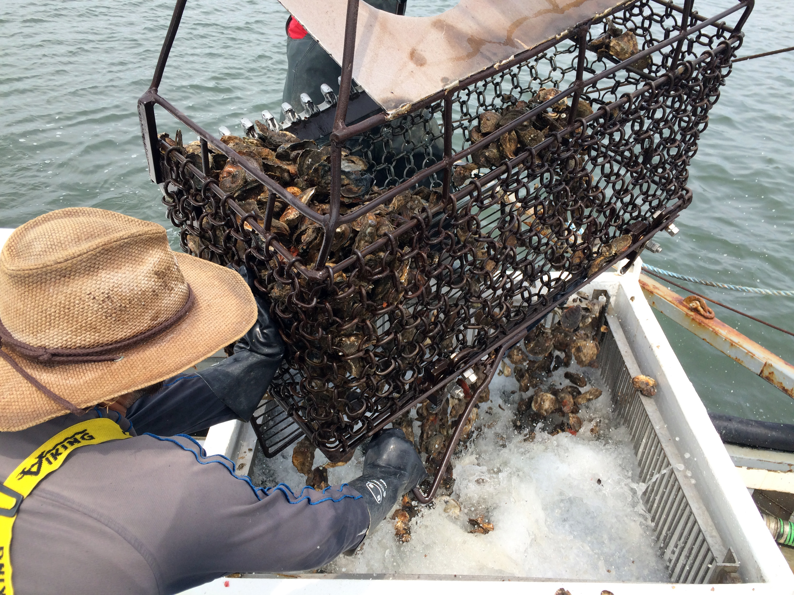

Slide 7
Vp Illness History in Connecticut: 2009 to 2016 Illness Summary

Slide 8
Illness History in Connecticut: 2009 to 2016 Vp Control Plan Summary
Year | VPCP Required? | Closure? | Hrs to TC | Hrs to 50°F
2009 | NO | NO | NA | NA
2010 | NO | NO | NA | NA
2011 | NO | NO | NA | NA
2012 | Mandatory | YES | 5 | 10
2013 | Mandatory | YES | 5 | Mandatory 10 Voluntary 5
2014 | Mandatory (2 VPCPs) | NO | 5/Rapid Cooling | 5/Rapid Cooling
2015 | Mandatory (2 VPCPs) | NO | 5/Rapid Cooling | 5/Rapid Cooling
2016 | Mandatory (2 VPCPs) | NO | 5/Rapid Cooling 68F | 5/Rapid Cooling 68F

Slide 9
VPCP Controls Utilized in 2017 | Total
5 hour to 50F direct ice | 1
5 hour to 50F mechanical refrigeration | 10
5 hour to 50F on-board mechanical refrigeration | 2
on-board direct ice | 1
on-board ice slurry | 10
Grand Total | 24

Slide 10
Vp Illness History in Connecticut: 2009 to 2016 VPCP Controls Associated with Illness

Slide 11
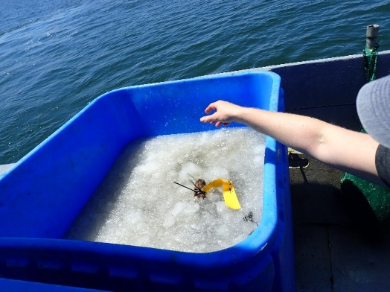
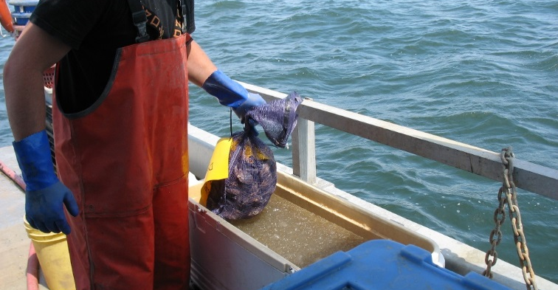
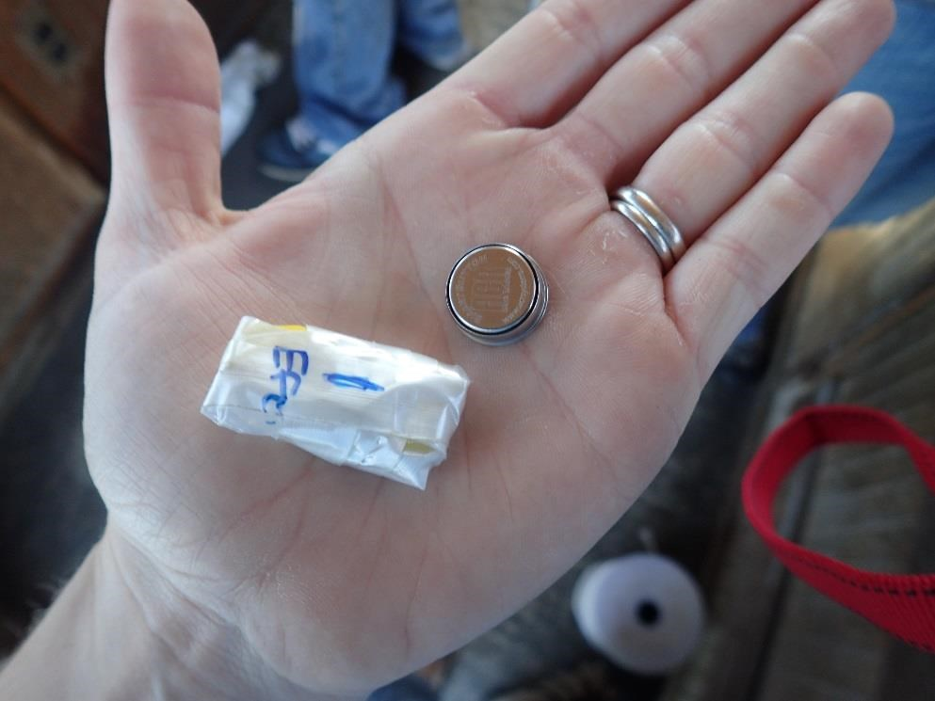
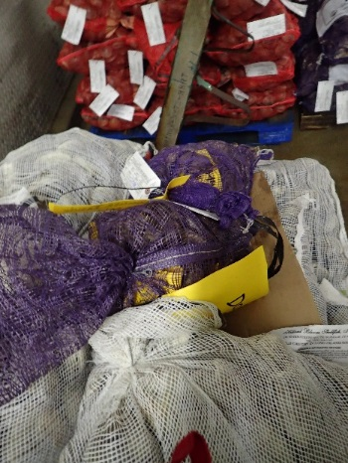
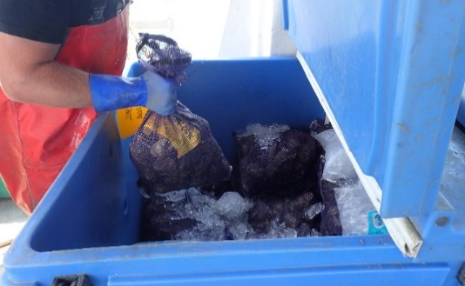
Industry Compliance with VPCP Controls Oyster with Smart Button data logger sent through process

Slide 12
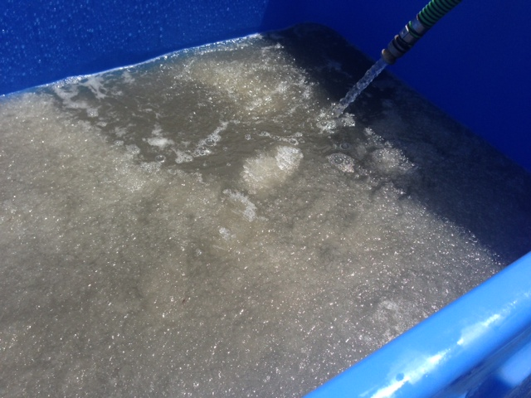
Cooling Profiles: Ice Slurry
Logger into Oyster 10:43
Unloading Temps Rise Quickly from 36 to 45°F
Oyster into Slurry 10:55
50°F at 11:01

Slide 13
Cooling Profile: Refrigerated Truck
Into Reefer at 1 pm
To 50°F at 4:11

Slide 14
Cooling Profile: Mechanical Refrigeration 5 Hours
Cooling Begins at 1:15 pm
To Internal Temp of 50F
At 6:15 pm

Slide 15
Internal Oyster Temp 5 Hours on Deck (8/18/15)

Slide 17
Log Total Vp MPN/g
TREATMENT

Slide 18
O4:K12
Outbreak pattern

Slide 19
2015 VPCP Risk Assessment: Water Temperatures Associated with CT Vp Illnesses

Slide 20
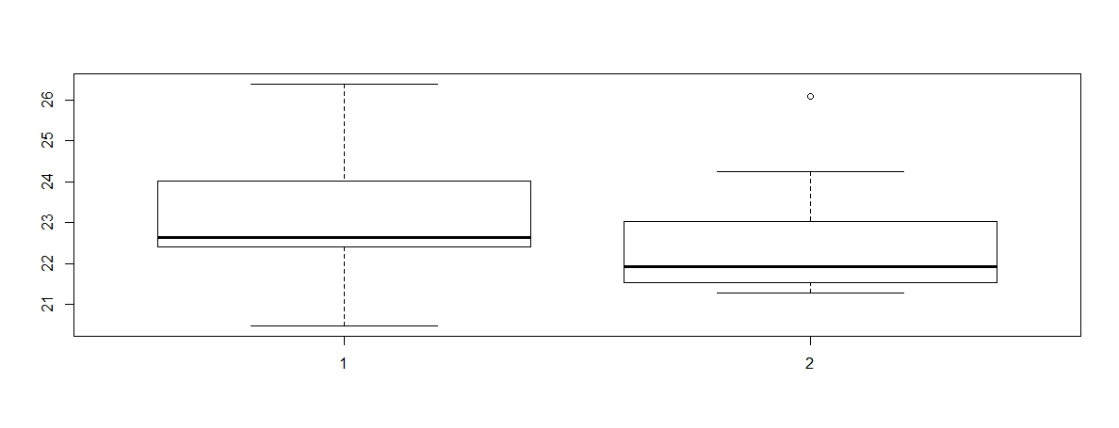
2015 VPCP Risk Assessment: Water Temperatures Associated with CT Vp Illnesses
NASA G1SST Daily Seawater Surface Temperature in C associated with Vp illnesses, plotted by Traceback Code. Only confirmed CT source cases, Code 1 cases are single CT source harvest location/date, code 2 cases were confirmed CT source, multiple potential CT harvest location/date.

Slide 21
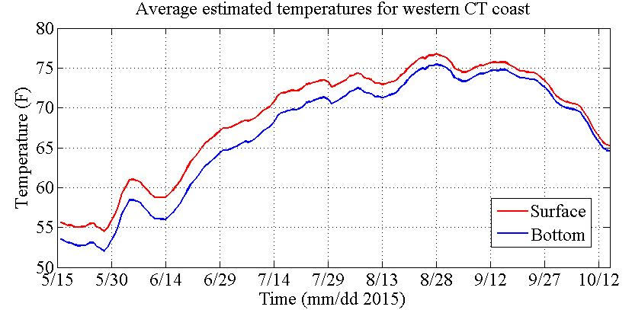
Case #2 Westport
Harvest Dates:
9/1/15 or 9/4/15
Case #1 Milford
Harvest Date: 8/29/15

Slide 22
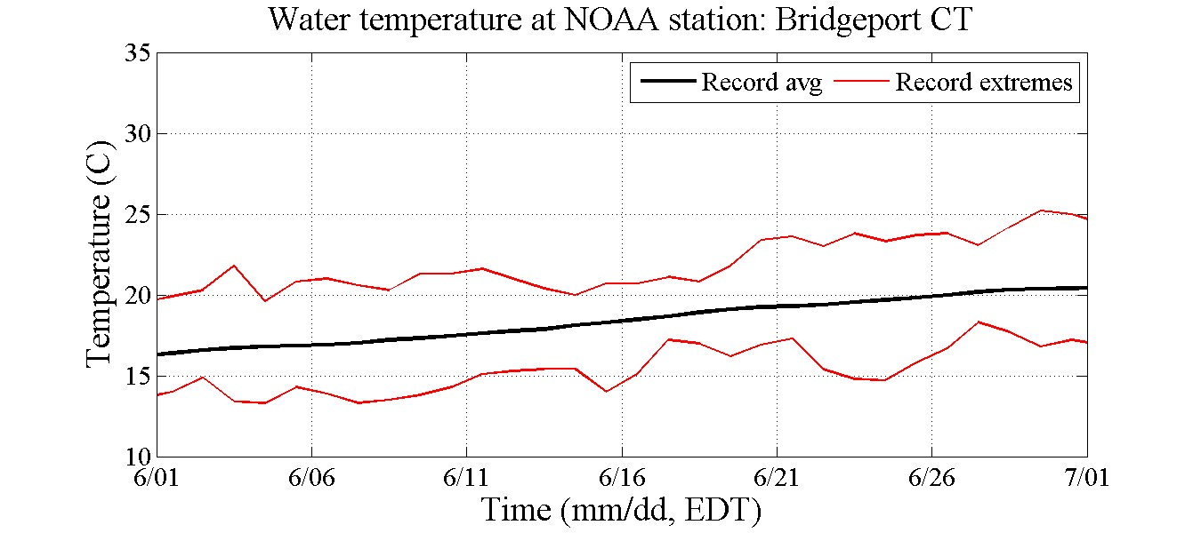
2015 VPCP: Water Temperature Trigger Based on Risk Assessment

Slide 23
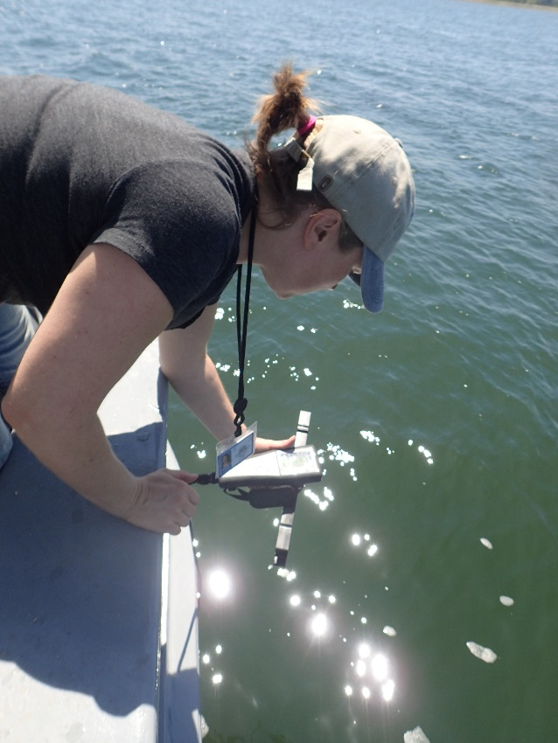
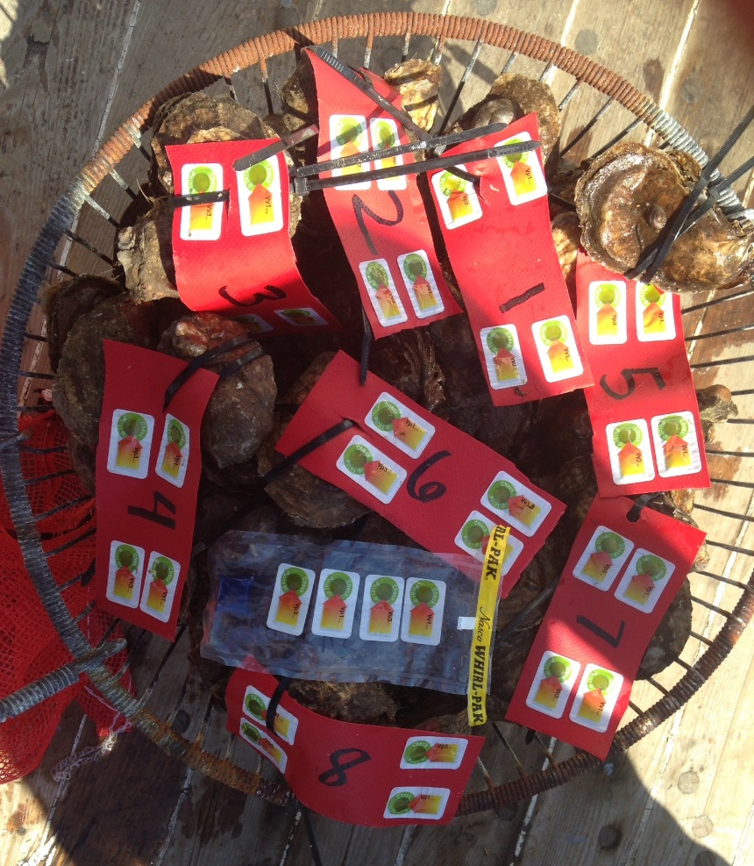
CT 2015 ISSC Study

Slide 24
CT 2015 ISSC Study: Techniques and Practices for Vp Reduction
Baseline/Zero Hour: Immediate rapid cooling to internal temperature of 50°F or less using ice slurry
1 hour from harvest to internal temperature of 50°F or less using ice slurry
3 hours from harvest to internal temperature of 50°F or less using ice slurry
5 hours from harvest to internal temperature of 50°F or less using ice slurry
NSSP standard VPCP: 5 hours from harvest into traditional mechanical temperature control and 10 hours to an internal temperature of 50°F

Slide 25
Process Study: Log Vp MPN/g

Slide 26
Tdh+/Trh+ Process Samples

Slide 27
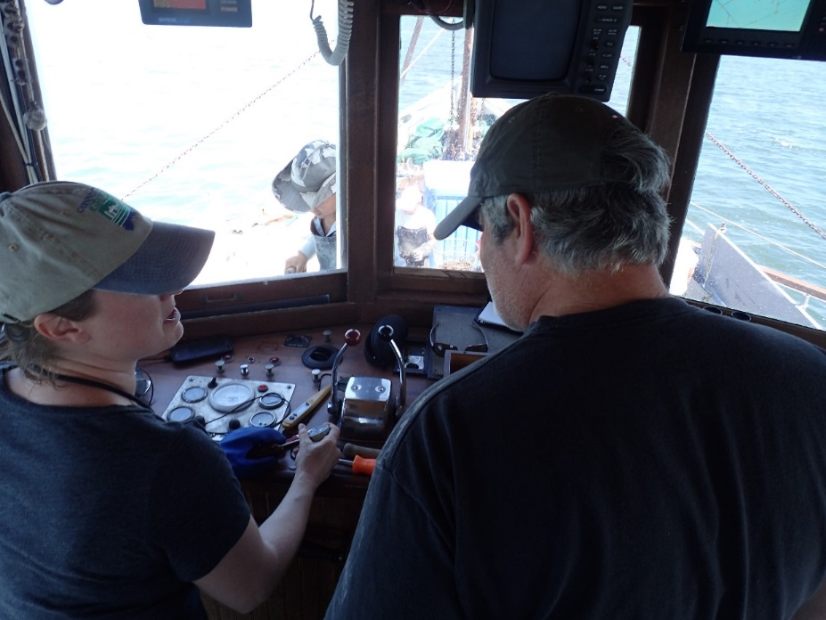
Acknowledgements and THANKS!!!
ISSC
USFDA
Andy DePaola, Jessica Jones, John Bowers, Amy Fitzpatrick, Don Ullstrom
UCONN Marine Science and Connecticut Sea Grant Partners
Michael Whitney, Evan Ward, Tessa Getchis
CT Industry Partners and Captains
Norm Bloom & Sons
CT Department of Public Health Epidemiology and Emerging Infections Program
Quyen Phan, MPH
Department of Agriculture Bureau of Aquaculture
David Carey, Director
Joseph DeCrescenzo, Alissa Dragan, David Lamoureux, Jr., Jenifer Yeadon

